Slide 1
Exploring the applications of artificial neural networks in catalysis: A case study with the water-gas shift reaction
Andrea Keane
December 18, 2017
Masters Defense, UW-Madison, Dept. of Chemical Engineering
supervised by
Prof. James A. Dumesic and Prof. George W. Huber
Notes:
Hi everyone! Today, I’m going to tell you about my project exploring the applications of artificial neural networks in catalysis using a case study of the water-gas shift reaction.

Slide 2
Motivations
Machine learning (ML) techniques, in conjunction with large catalytic datasets should be able to assist in identifying:
(1) meaningful material descriptors
(2) trends in reactivity (scaling relations)
(3) mechanistic differences between catalysts
Machine Learning
Catalytic Data
Materials
Descriptors
Scaling Relations
Mechanistic
Insight
This project details the exploration of these objectives using artificial neural networks (ANN), a type of ML, for the water-gas shift (WGS) reaction.
Notes:
Before jumping in to details, I would like to present the motivations for this project.
Theoretically, machine learning techniques in conjunction with large catalytic datasets should be able to assist in identifying (1), (2) and (3).
This project details the exploration of these objectives using artificial neural networks, a type of ML for the water-gas shift reaction.

Slide 3
Literature Context
Chemical Property
Attributes
Fixed Catalyst
Components
High Throughput
Experiments
K. Omata et al.
Industrial & Engineering
Chemistry Research
45.14 (2006).
K. Omata et al.
Industrial & Engineering Chemistry Research
43.13 (2004).
T. Hattori and S. Kito.
Catalysis Today
111.3 (2006).
S. Kito, T. Hattori, and Y. Murakami.
Applied Catalysis A: General
114.2 (1994).
K. Omata, Y. Kobayashi, and M. Yamada.
Catalysis Today
117.1 (2006).
Corma et al.
Journal of Catalysis
229.2 (2005).
S. Kito and T. Hattori.
Ind. Eng. Chem. Res.
31 (1991).
K. Omata et al.
Industrial & Engineering
Chemistry Research
48.13 (2009).
A. Corma et al.
ChemPhysChem
3.11 (2002).
K. Omata, Y. Kobayashi, and M. Yamada.
Catalysis Communications
8.1 (2007).
S. Kito et al.
Catalysis Today
97.1 (2004).
J. Serra et al.
Catalysis Today
81.3 (2003).
A. Corma et al.
Chemistry of Materials
18.14 (2006).
J. Serra et al.
Applied Catalysis A: General
254.1 (2003).
Notes:
Chemical Property Attributes – Used chemical properties to Describe materials
These can vary: boiling point and molecular weight to ionic radii and electronic characteristics
Fixed Catalyst Components - The range of catalysts was narrow either by fixing 2+ of the catalyst components (support, primary metal) or by fixing the components used and only changing the loading.
High Throughput Experiments – Generated data using high-throughput apparatuses
Citations:
Kito & Hattori
S. Kito et al. “Application of neural network to estimation of catalyst deactivation in methanol conversion”. In: Catalysis Today 97.1 (2004). Advanced Methods in Characterization of Catalysts and Materials, pp. 41–47. issn: 0920- 5861. doi: https://doi.org/10.1016/j.cattod.2004.04.052.
-- S. Kito et al. Catalysis Today 97.1 (2004).
Shigerharu Kito, Tadashi Hattori, and Yuichi Murakami. “Expert systems approach to computer-aided design of catalysts”. In: Applied Catalysis 48.1 (1989), pp. 107–121.
-- S. Kito, T. Hattori, and Y. Murakami. Applied Catalysis 48.1 (1989).
Shigerharu Kito and Tadashi Hattori. “Estimation of the Acid Strength of Mixed Oxides by a Neural Network”. In: Ind. Eng. Chem. Res. 31 (1991), pp. 979–981.
-- S. Kito and T. Hattori. Ind. Eng. Chem. Res. 31 (1991).
Shigeharu Kite, Tadashi Hattori, and Yuichi Murakami. “Estimation of catalytic performance by neural network a product distribution in oxidative dehydrogenation of ethylbenzene”. In: Applied Catalysis A: General 114.2 (1994), pp. L173–L178.
-- S. Kito, T. Hattori, and Y. Murakami. Applied Catalysis A: General 114.2 (1994).
Tadashi Hattori and Shigeharu Kito. “Analysis of factors controlling catalytic activity by neural network”. In: Catalysis Today 111.3 (2006), pp. 328–332. issn: 0920-5861.
Inputs: heat of formation of oxide per oxygen atom , typical valence of cation in oxide, electronegativity of cation, ionic radius of trivalent cation (r)
-- T. Hattori and S. Kito. Catalysis Today 111.3 (2006).
Omata & Yamada
Kohji Omata et al. “Simultaneous Optimization of Preparation Conditions and Composition of the Methanol Synthesis Catalyst by an All-Encompassing Calculation on an Artificial Neural Network”. In: Industrial & Engineering
Chemistry Research 43.13 (2004), pp. 3282–3288.
-- “the composition of the catalyst (Cu-Zn-Al-Sc-B-Zr), calcination temperature (300-360 °C), and amount of precipitant (1.0-2.5 times that equivalent to total cations) were optimized simultaneously”
-- K. Omata et al. Industrial & Engineering Chemistry Research 43.13 (2004).
Kohji Omata et al. “Design and Development of Cu-Zn Oxide Catalyst for Direct Dimethyl Ether Synthesis Using an Artificial Neural Network and Physicochemical Properties of Elements”. In: Industrial & Engineering Chemistry Re- search 45.14 (2006), pp. 4905–4910.
-- K. Omata et al. Industrial & Engineering Chemistry Research 45.14 (2006).
-- Cu-Zn-X oxide and γ-alumina was prepared for single-stage dimethyl ether synthesis
-- GPLE parameters and the physicochemical properties of the eight elements were used as training data for ANN.
Kohji Omata et al. “Artificial Neural Network (ANN)-Aided Optimization of ZSM-5 Catalyst for the Dimethyl Ether to Olefin (DTO) Reaction from Neat Dimethyl Ether (DME)”. In: Industrial & Engineering Chemistry Research 48.13 (2009), pp. 6256–6261.
-- Fixed ZSM-5 catalyst, escribed promoters w. physicochemical properties
-- K. Omata et al. Industrial & Engineering Chemistry Research 48.13 (2009).
Kohji Omata and Muneyoshi Yamada. “Prediction of Effective Additives to a Ni/Active Carbon Catalyst for Vapor-Phase Carbonylation of Methanol by an Artificial Neural Network”. In: Industrial & Engineering Chemistry Research 43.20 (2004), pp. 6622–6625.
-- K. Omata and M.Yamada. Industrial & Engineering Chemistry Research 43.20 (2004).
Kohji Omata, Yasukazu Kobayashi, and Muneyoshi Yamada. “Artificial neural network-aided design of Co/SrCO3 catalyst for preferential oxidation of CO in excess hydrogen”. In: Catalysis Today 117.1 (2006). The 5th World Congress on Oxidation Catalysis, pp. 311–315.
-- K. Omata, Y. Kobayashi, and M. Yamada. Catalysis Today 117.1 (2006).
Kohji Omata, Yasukazu Kobayashi, and Muneyoshi Yamada. “Artificial Neural Network Aided Screening and Optimization of Additives to Co/SrCO3 Catalyst for Dry Reforming of Methane under Pressure”. In: Energy & Fuels 23.4
43 (2009), pp. 1931–1935.
-- K. Omata, Y. Kobayashi, and M. Yamada. Energy & Fuels 23.443 (2009).
K. Omata, Y. Kobayashi, and M. Yamada. “Artificial neural network aided virtual screening of additives to a Co/SrCO3 catalyst for preferential oxidation of CO in excess hydrogen”. In: Catalysis Communications 8.1 (2007), pp. 1– 5.
-- K. Omata, Y. Kobayashi, and M. Yamada. Catalysis Communications 8.1 (2007).
Corma & Serra
Jose M. Serra et al. “Neural networks for modelling of kinetic reaction data applicable to catalyst scale up and process control and optimisation in the frame of combinatorial catalysis”. In: Applied Catalysis A: General 254.1 (2003). Combinatorial Chemistry, pp. 133–145.
-- J. Serra et al. Applied Catalysis A: General 254.1 (2003).
Jose M. Serra et al. “Can artificial neural networks help the experimentation in catalysis?” In: Catalysis Today 81.3 (2003). European Workshop on Combinatorial Catalysis, pp. 393–403.
-- Computational training data
-- J. Serra et al. Catalysis Today 81.3 (2003).
Corma et al. “Optimisation of olefin epoxidation catalysts with the application of high-throughput and genetic algorithms assisted by artificial neural networks (softcomputing techniques)”. In: Journal of Catalysis 229.2 (2005), pp. 513–52
-- Corma et al. Journal of Catalysis 229.2 (2005).
Avelino Corma et al. “Application of Artificial Neural Networks to Combinatorial Catalysis: Modeling and Predicting ODHE Catalysts”. In: ChemPhysChem 3.11 (2002), pp. 939–945
-- A. Corma et al. ChemPhysChem 3.11 (2002).
Avelino Corma et al. “A New Mapping/Exploration Approach for HT Synthesis of Zeolites”. In: Chemistry of Materials 18.14 (2006), pp. 3287–3296.
-- A. Corma et al. Chemistry of Materials 18.14 (2006).

Slide 4
Literature Context
Chemical Property
Attributes
Fixed Catalyst
Components
High Throughput
Experiments
Scaling relation
connection
Large dataset from
diverse sources
K. Omata et al.
Industrial & Engineering
Chemistry Research
45.14 (2006).
K. Omata et al.
Industrial & Engineering Chemistry Research
43.13 (2004).
T. Hattori and S. Kito.
Catalysis Today
111.3 (2006).
S. Kito, T. Hattori, and Y. Murakami.
Applied Catalysis A: General
114.2 (1994).
K. Omata, Y. Kobayashi, and M. Yamada.
Catalysis Today
117.1 (2006).
Corma et al.
Journal of Catalysis
229.2 (2005).
S. Kito and T. Hattori.
Ind. Eng. Chem. Res.
31 (1991).
K. Omata et al.
Industrial & Engineering
Chemistry Research
48.13 (2009).
A. Corma et al.
ChemPhysChem
3.11 (2002).
Incorporate DFT-calculated
binding energies
Attribute optimization &
analysis
K. Omata, Y. Kobayashi, and M. Yamada.
Catalysis Communications
8.1 (2007).
S. Kito et al.
Catalysis Today
97.1 (2004).
J. Serra et al.
Catalysis Today
81.3 (2003).
A. Corma et al.
Chemistry of Materials
18.14 (2006).
J. Serra et al.
Applied Catalysis A: General
254.1 (2003).
Notes:
Chemical Property Attributes – Used chemical properties to Describe materials
These can vary: boiling point and molecular weight to ionic radii and electronic characteristics
Fixed Catalyst Components - The range of catalysts was narrow either by fixing 2+ of the catalyst components (support, primary metal) or by fixing the components used and only changing the loading.
High Throughput Experiments – Generated data using high-throughput apparatuses
A natural questions then, is how will this work expand on previous publications. Novel by how we frame and approach the project.
First, no one has discussed a connection between ANNs and scaling relations. Framing this tool in a new light may drive the applications in different direction.
Second, nearly all of the previous models are based on high-throughput data which is typically collected less carefully. The original data set considered for this study included data from 97 publications over 10 years. This project uses data from numerous labs, researchers, with different instrumentation, materials and techniques.
Third, bring computational catalysis in by using DFT-binding energies. Present ANNs as a tool for bridging experimental catalysis and computational catalysis.
Finally, very little work has gone in to analyzing appropriate descriptors/attributes. This is two-fold improvement in that (1) forces inspection of the problem and the data at your disposal (2) eliminating non-necessary attributes improves model performance reduces bias.
Citations:
Kito & Hattori
S. Kito et al. “Application of neural network to estimation of catalyst deactivation in methanol conversion”. In: Catalysis Today 97.1 (2004). Advanced Methods in Characterization of Catalysts and Materials, pp. 41–47. issn: 0920- 5861. doi: https://doi.org/10.1016/j.cattod.2004.04.052.
-- S. Kito et al. Catalysis Today 97.1 (2004).
Shigerharu Kito, Tadashi Hattori, and Yuichi Murakami. “Expert systems approach to computer-aided design of catalysts”. In: Applied Catalysis 48.1 (1989), pp. 107–121.
-- S. Kito, T. Hattori, and Y. Murakami. Applied Catalysis 48.1 (1989).
Shigerharu Kito and Tadashi Hattori. “Estimation of the Acid Strength of Mixed Oxides by a Neural Network”. In: Ind. Eng. Chem. Res. 31 (1991), pp. 979–981.
-- S. Kito and T. Hattori. Ind. Eng. Chem. Res. 31 (1991).
Shigeharu Kite, Tadashi Hattori, and Yuichi Murakami. “Estimation of catalytic performance by neural network a product distribution in oxidative dehydrogenation of ethylbenzene”. In: Applied Catalysis A: General 114.2 (1994), pp. L173–L178.
-- S. Kito, T. Hattori, and Y. Murakami. Applied Catalysis A: General 114.2 (1994).
Tadashi Hattori and Shigeharu Kito. “Analysis of factors controlling catalytic activity by neural network”. In: Catalysis Today 111.3 (2006), pp. 328–332. issn: 0920-5861.
Inputs: heat of formation of oxide per oxygen atom , typical valence of cation in oxide, electronegativity of cation, ionic radius of trivalent cation (r)
-- T. Hattori and S. Kito. Catalysis Today 111.3 (2006).
Omata & Yamada
Kohji Omata et al. “Simultaneous Optimization of Preparation Conditions and Composition of the Methanol Synthesis Catalyst by an All-Encompassing Calculation on an Artificial Neural Network”. In: Industrial & Engineering
Chemistry Research 43.13 (2004), pp. 3282–3288.
-- “the composition of the catalyst (Cu-Zn-Al-Sc-B-Zr), calcination temperature (300-360 °C), and amount of precipitant (1.0-2.5 times that equivalent to total cations) were optimized simultaneously”
-- K. Omata et al. Industrial & Engineering Chemistry Research 43.13 (2004).
Kohji Omata et al. “Design and Development of Cu-Zn Oxide Catalyst for Direct Dimethyl Ether Synthesis Using an Artificial Neural Network and Physicochemical Properties of Elements”. In: Industrial & Engineering Chemistry Re- search 45.14 (2006), pp. 4905–4910.
-- K. Omata et al. Industrial & Engineering Chemistry Research 45.14 (2006).
-- Cu-Zn-X oxide and γ-alumina was prepared for single-stage dimethyl ether synthesis
-- GPLE parameters and the physicochemical properties of the eight elements were used as training data for ANN.
Kohji Omata et al. “Artificial Neural Network (ANN)-Aided Optimization of ZSM-5 Catalyst for the Dimethyl Ether to Olefin (DTO) Reaction from Neat Dimethyl Ether (DME)”. In: Industrial & Engineering Chemistry Research 48.13 (2009), pp. 6256–6261.
-- Fixed ZSM-5 catalyst, escribed promoters w. physicochemical properties
-- K. Omata et al. Industrial & Engineering Chemistry Research 48.13 (2009).
Kohji Omata and Muneyoshi Yamada. “Prediction of Effective Additives to a Ni/Active Carbon Catalyst for Vapor-Phase Carbonylation of Methanol by an Artificial Neural Network”. In: Industrial & Engineering Chemistry Research 43.20 (2004), pp. 6622–6625.
-- K. Omata and M.Yamada. Industrial & Engineering Chemistry Research 43.20 (2004).
Kohji Omata, Yasukazu Kobayashi, and Muneyoshi Yamada. “Artificial neural network-aided design of Co/SrCO3 catalyst for preferential oxidation of CO in excess hydrogen”. In: Catalysis Today 117.1 (2006). The 5th World Congress on Oxidation Catalysis, pp. 311–315.
-- K. Omata, Y. Kobayashi, and M. Yamada. Catalysis Today 117.1 (2006).
Kohji Omata, Yasukazu Kobayashi, and Muneyoshi Yamada. “Artificial Neural Network Aided Screening and Optimization of Additives to Co/SrCO3 Catalyst for Dry Reforming of Methane under Pressure”. In: Energy & Fuels 23.4
43 (2009), pp. 1931–1935.
-- K. Omata, Y. Kobayashi, and M. Yamada. Energy & Fuels 23.443 (2009).
K. Omata, Y. Kobayashi, and M. Yamada. “Artificial neural network aided virtual screening of additives to a Co/SrCO3 catalyst for preferential oxidation of CO in excess hydrogen”. In: Catalysis Communications 8.1 (2007), pp. 1– 5.
-- K. Omata, Y. Kobayashi, and M. Yamada. Catalysis Communications 8.1 (2007).
Corma & Serra
Jose M. Serra et al. “Neural networks for modelling of kinetic reaction data applicable to catalyst scale up and process control and optimisation in the frame of combinatorial catalysis”. In: Applied Catalysis A: General 254.1 (2003). Combinatorial Chemistry, pp. 133–145.
-- J. Serra et al. Applied Catalysis A: General 254.1 (2003).
Jose M. Serra et al. “Can artificial neural networks help the experimentation in catalysis?” In: Catalysis Today 81.3 (2003). European Workshop on Combinatorial Catalysis, pp. 393–403.
-- Computational training data
-- J. Serra et al. Catalysis Today 81.3 (2003).
Corma et al. “Optimisation of olefin epoxidation catalysts with the application of high-throughput and genetic algorithms assisted by artificial neural networks (softcomputing techniques)”. In: Journal of Catalysis 229.2 (2005), pp. 513–52
-- Corma et al. Journal of Catalysis 229.2 (2005).
Avelino Corma et al. “Application of Artificial Neural Networks to Combinatorial Catalysis: Modeling and Predicting ODHE Catalysts”. In: ChemPhysChem 3.11 (2002), pp. 939–945
-- A. Corma et al. ChemPhysChem 3.11 (2002).
Avelino Corma et al. “A New Mapping/Exploration Approach for HT Synthesis of Zeolites”. In: Chemistry of Materials 18.14 (2006), pp. 3287–3296.
-- A. Corma et al. Chemistry of Materials 18.14 (2006).

Slide 5
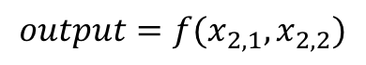
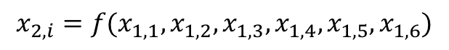
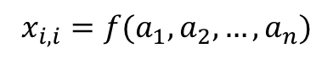
What is an Artificial Neural Network?
Inputs
Layer 1
X_{1,1}
Layer 2
X_{1,2}
X_{2,1}
X_{1,3}
$$output=f(x_{2,1},x_{2,2})$$
y
Output
X_{1,4}
$$x_{2,i}=f(x_{1,1}, x_{1,2},x_{1,3},x_{1,4},x_{1,5},x_{1,6})$$
X_{1,5}
X_{2,2}
X_{1,6}
$$x_{i,i}=f(a_{1}, a_{2}, …, a_{n})$$
(let a_{i} represent a single attribute/input)
Notes:
Many people discuss machine learning and ANNs as a “black box” where you put one thing in and get another out, without much thought or understanding of the contents of that box. However, ANNs an be mathematically represented. Considering the output as a function of its inputs and likewise, considering the output of each neuron in layer 2 as a function of the output of each neuron in layer 1, and then each output from the neurons in layer 1 as functions of in the ANN inputs, the ANN becomes a relatively long, but repetitive and predictable, mathematical expression consisting of weighted summations and activation functions.
Understanding the contents of the black box allows us o draw relationships between the traditional catalytic scaling relations and ANNs.
In catalysis, scaling relations have been successfully used to drive development of novel catalytic materials and predict catalytic activity. We are most familiar with linear scaling relationships. Let’s consider the general definition of a scaling relation as Any relationship in which a change to one variable causes a predictable and defined change in another variable.
Unlike traditional linear scaling relationships with a single input, ANNs can support an unlimited number of inputs. Thus, it becomes clear that ANNs can be framed as complex scaling relation tools that allow us to draw predictable conclusions from highly dimensional problems.

Slide 6
What is an Artificial Neural Network?
Inputs
Layer 1
Scaling Relation:
Any relationship in which a change to one variable causes a predictable and defined change in another variable.
X_{1,1}
Layer 2
X_{1,2}
X_{2,1}
X_{1,3}
$$output=f(x_{2,1},x_{2,2})$$
y
Output
X_{1,4}
$$x_{2,i}=f(x_{1,1}, x_{1,2},x_{1,3},x_{1,4},x_{1,5},x_{1,6})$$
X_{1,5}
X_{2,2}
X_{1,6}
$$x_{i,i}=f(a_{1}, a_{2}, …, a_{n})$$
(let a_{i} represent a single attribute/input)
Notes:
Understanding the contents of the black box allows us o draw relationships between the traditional catalytic scaling relations and ANNs.
In catalysis, scaling relations have been successfully used to drive development of novel catalytic materials and predict catalytic activity. We are most familiar with linear scaling relationships. Let’s consider the general definition of a scaling relation as Any relationship in which a change to one variable causes a predictable and defined change in another variable.
Unlike traditional linear scaling relationships with a single input, ANNs can support an unlimited number of inputs. Thus, it becomes clear that ANNs can be framed as complex scaling relation tools that allow us to draw predictable conclusions from highly dimensional problems.

Slide 7
Data Loss Through Cleaning
Removal Criteria | Order Independent | Sequential Removal | Remaining Data Points
Original Data | --- | --- | 4360
97 publications
Years 2002 - 2012
C. Odabasi, M Gunay, and R. Yildirim. “Knowledge extraction for water gas shift reaction over noble metal catalysts from publications in the literature between 2002 and 2012”. International Journal of Hydrogen Energy 39 (Apr. 2014).
Notes:
In order to develop an ANN, a dataset of “labeled” training data is needed. For this project, we used a previously published dataset consisting of 4,360 instances of experimental WGS reaction data from 97 publications across a 1o-year timespan. This data was collected by Odabasi, Gunay and Yildirim. However, data “cleaning” was needed to increase the usefulness of the model.
Cagla Odabasi, M Gunay, and Ramazan Yildirim. “Knowledge extraction for water gas shift reaction over noble metal catalysts from publications in the literature between 2002 and 2012”. In: International Journal of Hydrogen Energy 39 (Apr. 2014).

Slide 8
Data Loss Through Cleaning
Removal Criteria | Order Independent | Sequential Removal | Remaining Data Points
Original Data | --- | --- | 4360
Zeolite Support | 66 | 66 | 4294
Hydroxyapatite Support | 58 | 58 | 4236
Activated Carbon Support | 25 | 25 | 4211
YSZ Promoter | 21 | 21 | 4190
CH₄ Co-Feed | 223 | 223 | 3967
O₂ Co-Feed | 98 | 32 | 3935
149
Instances
C. Odabasi, M Gunay, and R. Yildirim. “Knowledge extraction for water gas shift reaction over noble metal catalysts from publications in the literature between 2002 and 2012”. International Journal of Hydrogen Energy 39 (Apr. 2014).
Notes:
Limited the dataset to only include single metal-oxide supports and pure metallic promoters. Thus, approx. 200 instances with zeolite, HAP, ACC supports, as well as YSZ promoters were removed. Furthermore, the dataset was limited to only include he WGS reaction, so approx 250 instances with additional feed gases (methane, oxygen) were removed.
Cagla Odabasi, M Gunay, and Ramazan Yildirim. “Knowledge extraction for water gas shift reaction over noble metal catalysts from publications in the literature between 2002 and 2012”. In: International Journal of Hydrogen Energy 39 (Apr. 2014).

Slide 9
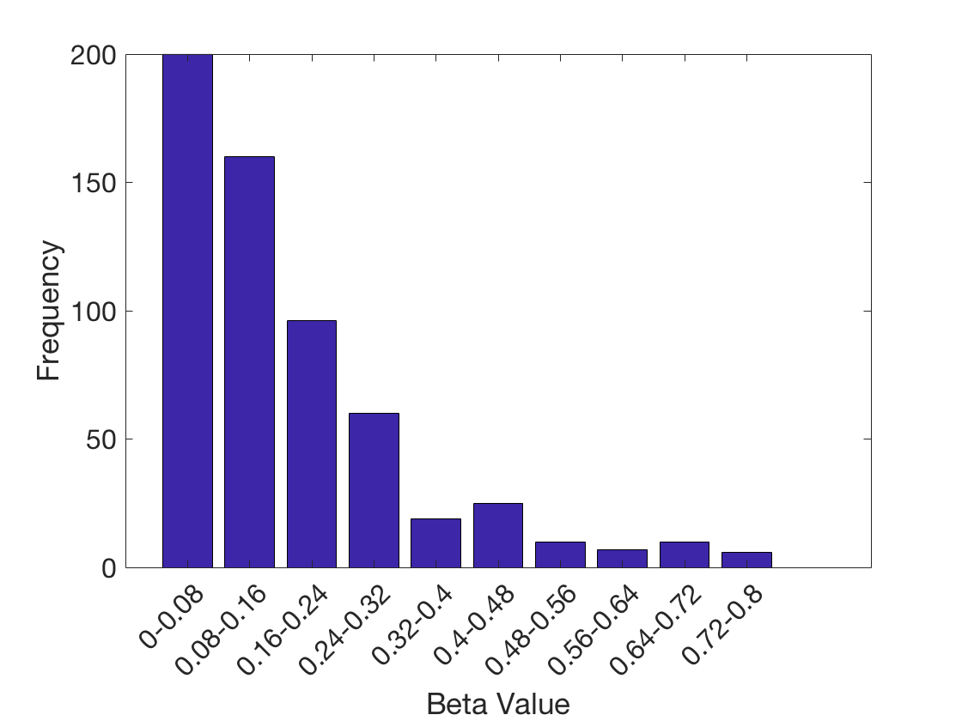
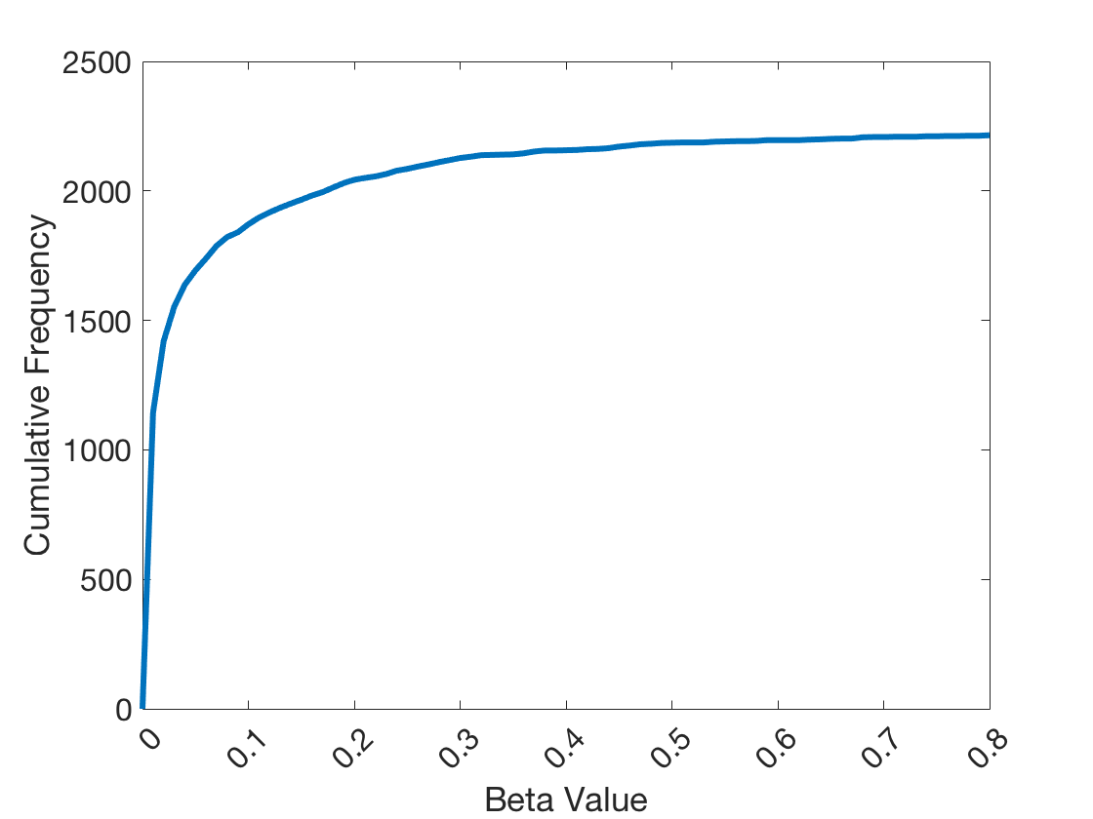
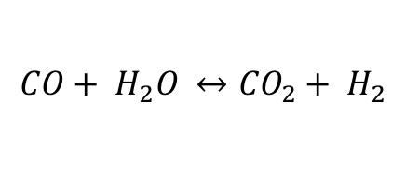
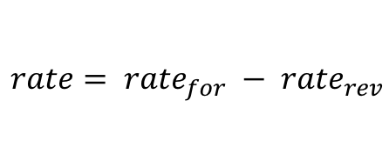
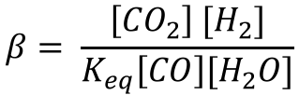
Data Loss Through Cleaning
Removal Criteria | Order Independent | Sequential Removal | Remaining Data Points
Original Data | --- | --- | 4360
Zeolite Support | 66 | 66 | 4294
Hydroxyapatite Support | 58 | 58 | 4236
Activated Carbon Support | 25 | 25 | 4211
YSZ Promoter | 21 | 21 | 4190
CH₄ Co-Feed | 223 | 223 | 3967
O₂ Co-Feed | 98 | 32 | 3935
Beta > 0.8 | 355 | 265 | 3670
Beta < 0 | 124 | 66 | 3604
Beta not Calculable | 177 | 176 | 3428
507
Instances
$$CO+ H_{2}O ↔{CO}_{2}+ H_{2}$$
$$rate= {rate}_{for} − {rate}_{rev}$$
$$β= \frac{\left[{CO}_{2}\right] [H_{2}]}{K_{eq}\left[CO\right][H_{2}O]}$$
C. Odabasi, M Gunay, and R. Yildirim. “Knowledge extraction for water gas shift reaction over noble metal catalysts from publications in the literature between 2002 and 2012”. International Journal of Hydrogen Energy 39 (Apr. 2014).
Notes:
The “Beta” cleaning resulted in the loss of 507 instances while limiting the data to the LT-WGS range resulted in the loss of 558 instances. Additionally, a remaining 642, instances with mixed-supports were removed.
Cagla Odabasi, M Gunay, and Ramazan Yildirim. “Knowledge extraction for water gas shift reaction over noble metal catalysts from publications in the literature between 2002 and 2012”. In: International Journal of Hydrogen Energy 39 (Apr. 2014).

Slide 10
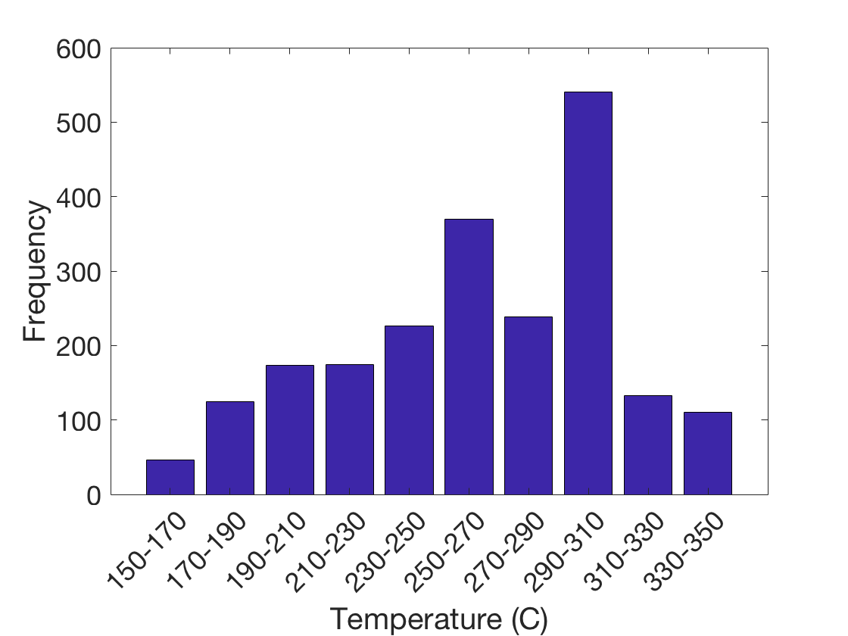
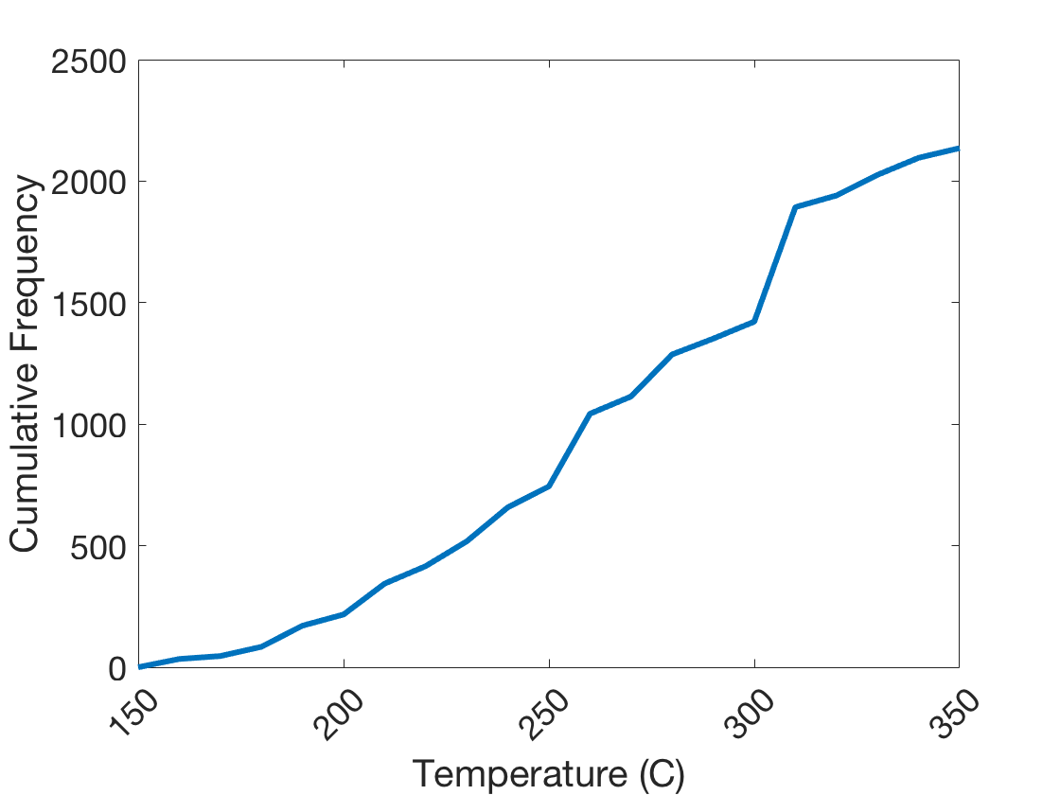
Data Loss Through Cleaning
Removal Criteria | Order Independent | Sequential Removal | Remaining Data Points
Original Data | --- | --- | 4360
Zeolite Support | 66 | 66 | 4294
Hydroxyapatite Support | 58 | 58 | 4236
Activated Carbon Support | 25 | 25 | 4211
YSZ Promoter | 21 | 21 | 4190
CH₄ Co-Feed | 223 | 223 | 3967
O₂ Co-Feed | 98 | 32 | 3935
Beta > 0.8 | 355 | 265 | 3670
Beta < 0 | 124 | 66 | 3604
Beta not Calculable | 177 | 176 | 3428
T < 150 ℃ | 173 | 118 | 3310
T > 350 ℃ | 730 | 440 | 2870
Mixed Supports | 953 | 642 | 2228
558
Instances
Limiting to Low-Temperature WGS
150 ℃ - 350 ℃
C. Odabasi, M Gunay, and R. Yildirim. “Knowledge extraction for water gas shift reaction over noble metal catalysts from publications in the literature between 2002 and 2012”. International Journal of Hydrogen Energy 39 (Apr. 2014).
Notes:
while limiting the data to the LT-WGS range resulted in the loss of 558 instances. Additionally, a remaining 642, instances with mixed-supports were removed.
Cagla Odabasi, M Gunay, and Ramazan Yildirim. “Knowledge extraction for water gas shift reaction over noble metal catalysts from publications in the literature between 2002 and 2012”. In: International Journal of Hydrogen Energy 39 (Apr. 2014).

Slide 11
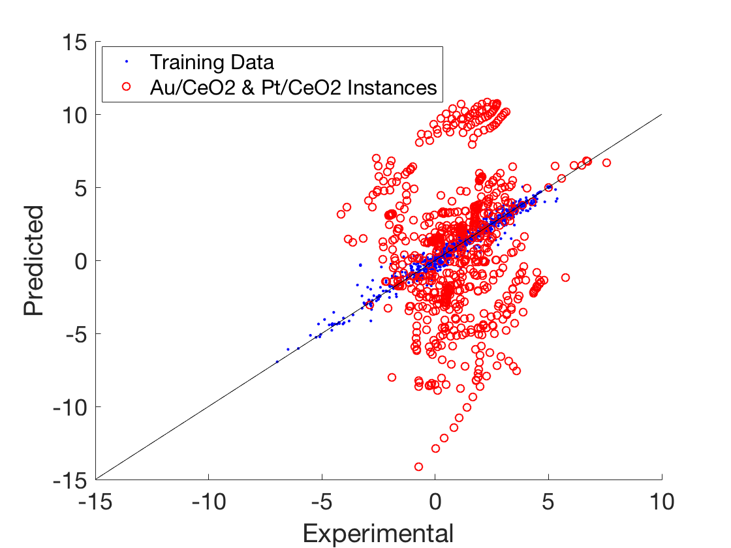
Data Loss Through Cleaning
Removal Criteria | Order Independent | Sequential Removal | Remaining Data Points
Original Data | --- | --- | 4360
Zeolite Support | 66 | 66 | 4294
Hydroxyapatite Support | 58 | 58 | 4236
Activated Carbon Support | 25 | 25 | 4211
YSZ Promoter | 21 | 21 | 4190
CH₄ Co-Feed | 223 | 223 | 3967
O₂ Co-Feed | 98 | 32 | 3935
Beta > 0.8 | 355 | 265 | 3670
Beta < 0 | 124 | 66 | 3604
Beta not Calculable | 177 | 176 | 3428
T < 150 ℃ | 173 | 118 | 3310
T > 350 ℃ | 730 | 440 | 2870
Mixed Supports | 953 | 642 | 2228
Data Set | R² | MSE
With Au/CeO2 & Pt/CeO2 | 0.91 | 0.32
Without Au/CeO2 & Pt/CeO2 | 0.95 | 0.24
Difference | 0.03 | 0.08
Removing Au/CeO₂ & Pt/CeO₂ 2228 → 1,499
C. Odabasi, M Gunay, and R. Yildirim. “Knowledge extraction for water gas shift reaction over noble metal catalysts from publications in the literature between 2002 and 2012”. International Journal of Hydrogen Energy 39 (Apr. 2014).
Notes:
Finally, 753 data points for Au/CeO2 and Pt/CeO2 catalysts were removed because they were consistently outliers during model development and reasonable evidence exists that suggests these catalysts operate through a unique mechanism. Removal of these data points resulted in a a significant improvement in the error analysis. When the developed model was used to make predictions for the removed Au/CeO2 and Pt/CeO2 data points, it was clear that these instances do not follow the developed scaling relation.
Cagla Odabasi, M Gaenay, and Ramazan Yildirim. “Knowledge extraction for water gas shift reaction over noble metal catalysts from publications in the literature between 2002 and 2012”. In: International Journal of Hydrogen Energy 39 (Apr. 2014).

Slide 12
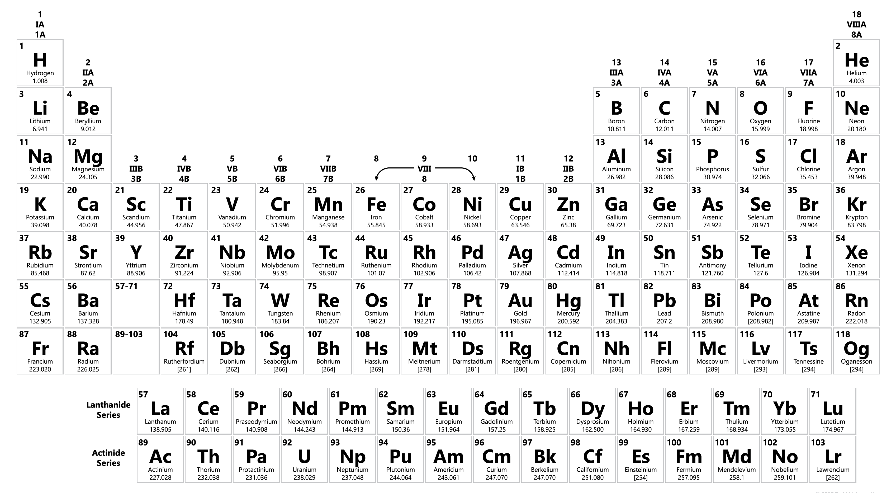
Domain space: Elemental Representation
Supports
Primary
Metals
Promoters
Notes:
After cleaning the data, features were selected to transform the originally categorical data into continuous data.
After the data cleaning procedure, the domain consisted of instances with the demosnstrated catalytic materials.

Slide 13
Attribute Determination: Primary Metal
Comparison of Training Performance using Each
Binding Energy as a Primary Metal Attribute
Binding Energy (eV) of Selected Adsorbates on Primary Metals
Surface | C | CO | H | O | OH
Au(111) | -3.06 | 0.3 | -1.84 | -1.94 | -1.06
Cu(111) | -3.75 | -0.33 | -2.2 | -3.58 | -2.13
Pt(111) | -5.81 | -1.34 | -2.57 | -3.18 | -1.65
Pd(111) | -5.62 | -1.49 | -2.62 | -3.14 | -1.65
Ir(111) | -6.46 | -1.52 | -2.61 | -4.14 | -2.12
Rh(111) | -5.67 | -1.51 | -2.64 | -4.13 | -2.14
Ru(0001) | -6.16 | -3.47 | -2.75 | -4.73 | -2.64
Primary Metal Descriptor, Binding Species | MSE | R²
C | 0.49 | 0.87
CO | 0.55 | 0.86
H | 0.56 | 0.85
O | 0.58 | 0.85
OH | 0.59 | 0.85
Jeffrey A. Herron et al. “Trends in Formic Acid Decomposition on Model Transition Metal Surfaces: A Density Functional Theory study”. In: ACS Catalysis 4.12 (2014), pp. 4434–4445.
Notes:
BE –carbon seemed to be the best primary metal attribute.

Slide 14
Attribute Determination
Support Descriptor | MSE | R²
First Ionization Energy | 0.26 | 0.93
Electronegativity | 0.29 | 0.93
MW of Metal Oxide | 0.32 | 0.92
MW of Metal | 0.33 | 0.91
Highest Oxidation State | 0.36 | 0.91
Reduction Potential | 0.38 | 0.90
Lowest Reduction State | 0.39 | 0.90
Promoters
Primary Metal
Primary Metal
Primary Metal
Support

Slide 15
Attribute Determination
Support Descriptor | MSE | R²
First Ionization Energy | 0.26 | 0.93
Electronegativity | 0.29 | 0.93
MW of Metal Oxide | 0.32 | 0.92
MW of Metal | 0.33 | 0.91
Highest Oxidation State | 0.36 | 0.91
Reduction Potential | 0.38 | 0.90
Lowest Reduction State | 0.39 | 0.90
Promoter Descriptor | MSE | R²
Charge/Ionic Radius | 0.275 | 0.93
Electronegativity | 0.296 | 0.92
First Ionization Energy | 0.300 | 0.92
Reduction Potential | 0.302 | 0.92
Molecular Weight | 0.306 | 0.92
Most Reduced State | 0.312 | 0.92
Most Oxidized State | 0.315 | 0.92
Promoters
Primary Metal
Primary Metal
Primary Metal
Support

Slide 16
Domain space: Attribute Representation
Attribute |  | Minimum | Maximum
Binding Energy Carbon | (eV) | -6.46 | -3.06
Primary Metal Loading | (wt%) | 0.1 | 39.8
Promoter Charge/Ionic Radius | (charge/pm) | 0.06 (0) | 1.52
Promoter Electronegativity | (Pauling Scale) | 0.79 (0) | 1.91
Promoter Loading | (wt%) | 0 | 20
Support Metal, First Ionization Energy | (kJ/mol) | 534.40 | 786.50
Support Metal, Electronegativity | (Pauling Scale) | 1.1 | 1.9
Synthesis Method |  | IWI, WI, CI, SI, HDP, FSP, DP
Calcination Temperature | (Celsius) | 25 | 650
Calcination Time | (hours) | 0 | 10
Promoters
Primary Metal
Primary Metal
Primary Metal
Support

Slide 17
Domain space: Attribute Representation
Attribute |  | Minimum | Maximum
Binding Energy Carbon | (eV) | -6.46 | -3.06
Primary Metal Loading | (wt%) | 0.1 | 39.8
Promoter Charge/Ionic Radius | (charge/pm) | 0.06 (0) | 1.52
Promoter Electronegativity | (Pauling Scale) | 0.79 (0) | 1.91
Promoter Loading | (wt%) | 0 | 20
Support Metal, First Ionization Energy | (kJ/mol) | 534.40 | 786.50
Support Metal, Electronegativity | (Pauling Scale) | 1.1 | 1.9
Synthesis Method |  | IWI, WI, CI, SI, HDP, FSP, DP
Calcination Temperature | (Celsius) | 25 | 650
Calcination Time | (hours) | 0 | 10
Reaction Temperature | (Kelvin) | 423 | 623
Reactant Feed, H₂ vol% |  | 0 | 60
Reactant Feed, CO vol% |  | 0.2 | 12
Reactant Feed, H₂O vol% |  | 2 | 60
Reactant Feed, CO₂ vol% |  | 0 | 15
Time on Stream | (min) | 0.8 | 4314
Total Inlet Flowrate/Catalyst Mass | (mL/min/g) | 0.028 | 17.6
Promoters
Primary Metal
Primary Metal
Primary Metal
Support
Reactor
H₂
CO
CO₂
H₂O
Notes:
IWI - incipient wetness impregnation
WI – wet impregnation
CI – co-impregnation
SI – sequential impregnation
HDP - homogenous deposition precipitation
FSP – flame spray pyrolysis
DP – deposition precipitation

Slide 18
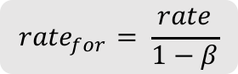
Optimized Artificial Neural Network
Attributes (23)
Binding Energy Carbon
Primary Metal Loading
Promoter Charge/Ionic Radius
Promoter Electronegativity
Promoter Loading
Support Metal, First Ionization Energy
Support Metal, Electronegativity
Synthesis Method (IWI, WI, CI, SI, HDP, FSP, DP)
Calcination Temperature
Calcination Time
Reaction Temperature
Reactant Feed, H₂ vol%
Reactant Feed, CO vol%
Reactant Feed, H₂O vol%
Reactant Feed, CO₂ vol%
Time on Stream
Total Inlet Flowrate/Catalyst Mass
Inputs
Layer 1
X_{1,1}
Layer 2
X_{1,2}
X_{2,1}
X_{1,3}
$${rate}_{for}= \frac{rate}{1−β}$$
y
X_{1,4}
X_{1,5}
X_{2,2}
X_{1,6}
Notes:
The normalized ANN results in 23 inputs (7 of which are binary, non-continuous attributes for the synthesis method). An optimum architecture search suggested that the optimum architecture for this ANN was 6 neurons in the first layer, 2 neurons in the second layer.
The output is the forward rate.

Slide 19
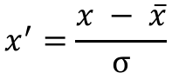
Data Normalization
Attribute | Min | Max
Binding Energy Carbon | -1.2 | 3.6
Primary Metal Loading | -0.39 | 8.9
Promoter Charge/Ionic Radius | -0.85 | 3.4
Promoter Electronegativity | -1.2 | 1.6
Promoter Loading | -0.61 | 3.2
Support Metal, First Ionization Energy | -1.7 | 3.0
Support Metal, Electronegativity | -3.2 | 2.6
Calcination Temperature | -1.1 | 1.9
Calcination Time | -0.92 | 4.8
Reaction Temperature | -2.4 | 1.7
Reactant Feed, H₂ vol% | -0.75 | 2.3
Reactant Feed, CO vol% | -1.9 | 3.6
Reactant Feed, H₂O vol% | -1.1 | 3.6
Reactant Feed, CO₂ vol% | -0.66 | 2.9
Time on Stream | -0.80 | 9.6
Total Inlet Flowrate/Catalyst Mass | -9.9 | 5.5
Attribute Normalization
(except Synthesis methods)
$$x^{′}=\frac{x − \overline{x}}{σ}$$
Notes:
Called the “Standard Score”

Slide 20
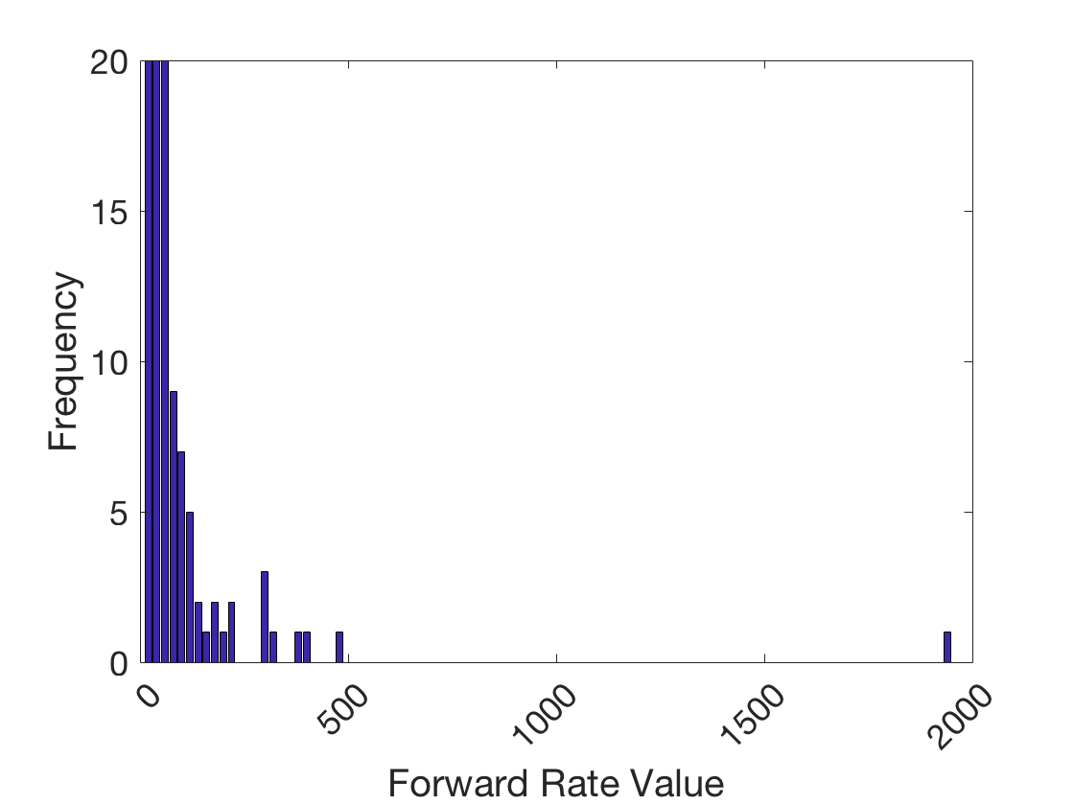
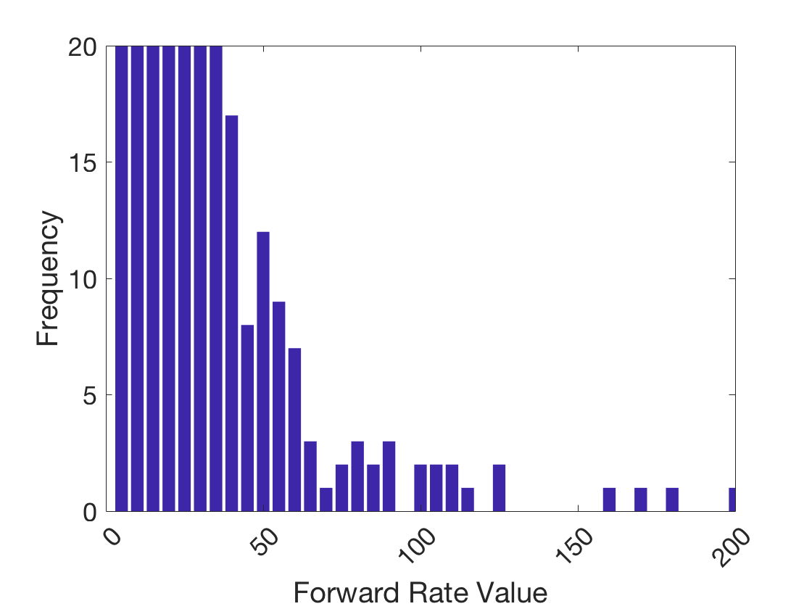
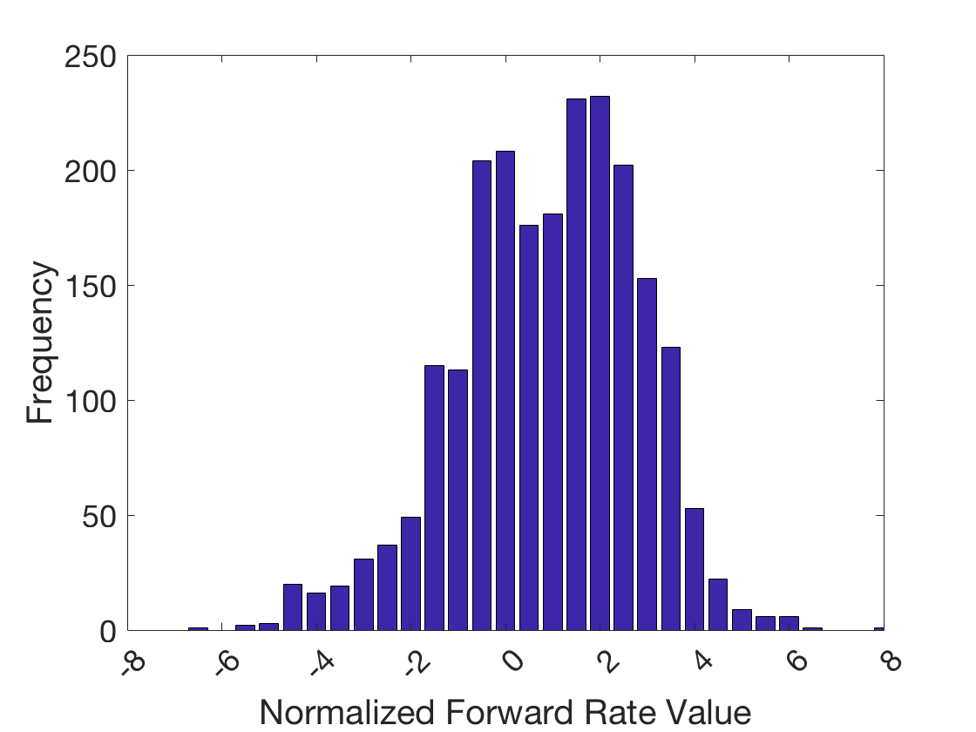
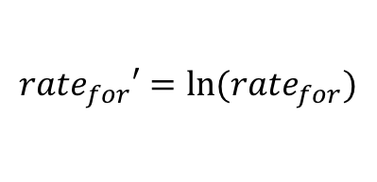
Data Normalization
Attribute | Min | Max
Binding Energy Carbon | -1.2 | 3.6
Primary Metal Loading | -0.39 | 8.9
Promoter Charge/Ionic Radius | -0.85 | 3.4
Promoter Electronegativity | -1.2 | 1.6
Promoter Loading | -0.61 | 3.2
Support Metal, First Ionization Energy | -1.7 | 3.0
Support Metal, Electronegativity | -3.2 | 2.6
Calcination Temperature | -1.1 | 1.9
Calcination Time | -0.92 | 4.8
Reaction Temperature | -2.4 | 1.7
Reactant Feed, H₂ vol% | -0.75 | 2.3
Reactant Feed, CO vol% | -1.9 | 3.6
Reactant Feed, H₂O vol% | -1.1 | 3.6
Reactant Feed, CO₂ vol% | -0.66 | 2.9
Time on Stream | -0.80 | 9.6
Total Inlet Flowrate/Catalyst Mass | -9.9 | 5.5
Attribute Normalization
(except Synthesis methods)
$$x^{′}=\frac{x − \overline{x}}{σ}$$
Output Normalization
$${rate}_{for}′=ln⁡({rate}_{for})$$

Slide 21
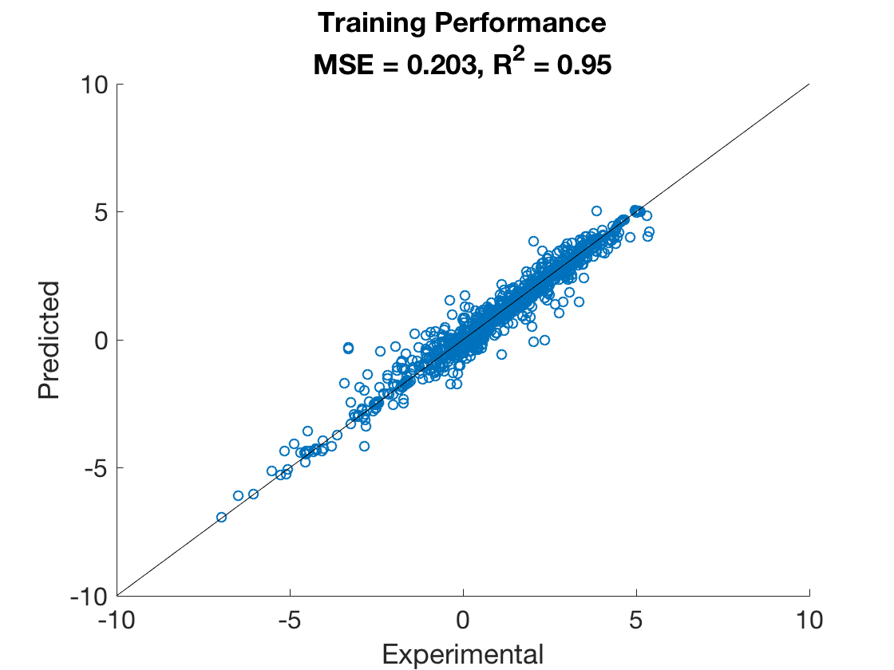
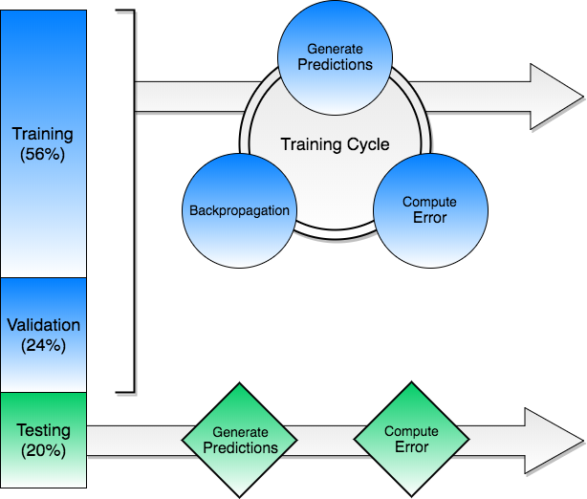
Data Division & Training
Notes:
Default: Levenberg-Marquardt
Modified: Bayesian Regularization

Slide 22
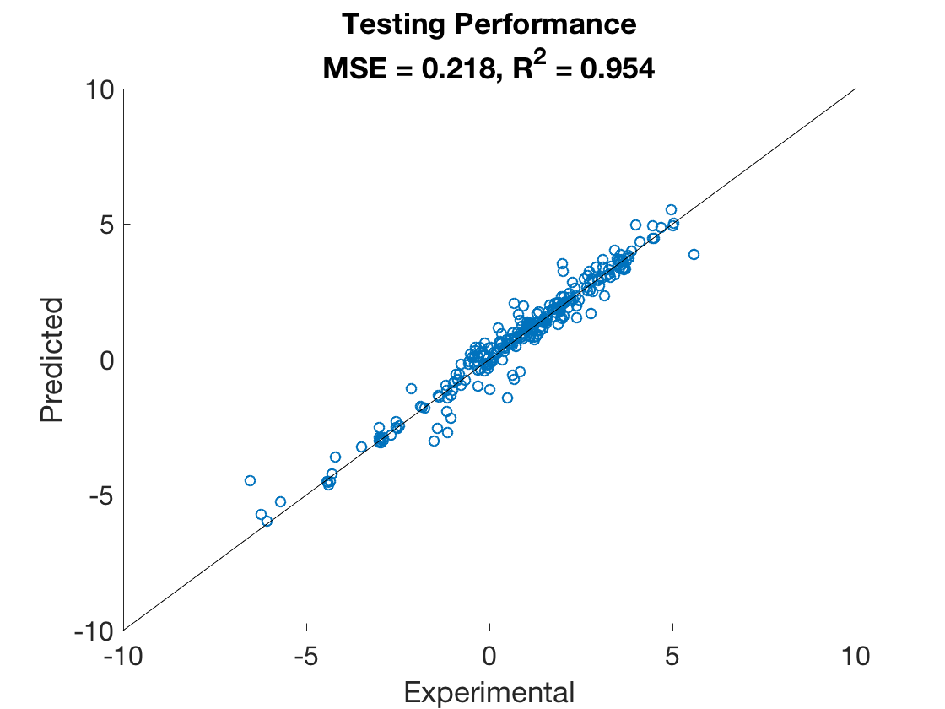
Data Division & Training
Good Agreement
Between Training
& Testing Analysis

Slide 23
Optimum Catalyst
Search Results for Optimum Catalyst
Attribute | Optimum
Binding Energy Carbon (eV) | -5.81 | Pt
Primary Metal Loading (wt%) | 0.2
Promoter Charge/Ionic Radius (charge/pm) | 0.36
Promoter Electronegativity (Pauling Scale) | 1.91 | Ni
Promoter Loading (wt%) | 15
Support Metal, First Ionization Energy (kJ/mol) | 578 | Al₂O₃
Support Metal, Electronegativity (Pauling Scale) | 1.61
Synthesis Method | IWI
Calcination Temperature (Celsius) | 500
Calcination Time (hours) | 4
Reaction Temperature (Kelvin) | 623
Reactant Feed, H2 vol% | 0
Reactant Feed, CO vol% | 3
Reactant Feed, H2O vol% | 6
Reactant Feed, CO vol% | 0
Time on Stream (min) | 60
Total Inlet Flowrate/Catalyst Mass (mL/min/g) | 2

Slide 24
Sensitivity Analysis
Attribute | MSE | R²
No Attributes Removed, Base Case | 0.420 | 0.90
Binding Energy Carbon | 0.577 | 0.87
Primary Metal Loading, wt% | 0.454 | 0.89
Promoter Charge/Ionic Radius | 0.385 | 0.91
Promoter Electronegativity | 0.366 | 0.92
Promoter Loading, wt% | 0.348 | 0.91
Support, First Ionization Energy | 0.403 | 0.91
Support, Electronegativity | 0.414 | 0.90
Synthesis | 0.419 | 0.90
Calcination Temperature, C | 0.316 | 0.92
Calcination Time | 0.415 | 0.90
Reaction Temperature | 1.244 | 0.70
Reactant Feed, H2 vol% | 0.449 | 0.90
Reactant Feed, CO vol% | 0.430 | 0.90
Reactant Feed, H2O vol% | 0.446 | 0.90
Reactant Feed, CO2 vol% | 0.371 | 0.91
Time on Stream (min) | 0.357 | 0.92
Total Inlet Flowrate/Catalyst Mass | 0.463 | 0.90
Methodology:
Removed attributes one-at-a-time
Randomized data and trained new ANN
Reported average MSE and R²
Most sensitive to BE_{C} & Reaction Temperature
Notes:
Note: Dominating temperature effects

Slide 25
Sensitivity Analysis
Attribute | MSE | R²
No Attributes Removed, Base Case | 0.420 | 0.90
Binding Energy Carbon | 0.577 | 0.87
Primary Metal Loading, wt% | 0.454 | 0.89
Promoter Charge/Ionic Radius | 0.385 | 0.91
Promoter Electronegativity | 0.366 | 0.92
Promoter Loading, wt% | 0.348 | 0.91
Support, First Ionization Energy | 0.403 | 0.91
Support, Electronegativity | 0.414 | 0.90
Synthesis | 0.419 | 0.90
Calcination Temperature, C | 0.316 | 0.92
Calcination Time | 0.415 | 0.90
Reaction Temperature | 1.244 | 0.70
Reactant Feed, H2 vol% | 0.449 | 0.90
Reactant Feed, CO vol% | 0.430 | 0.90
Reactant Feed, H2O vol% | 0.446 | 0.90
Reactant Feed, CO2 vol% | 0.371 | 0.91
Time on Stream (min) | 0.357 | 0.92
Total Inlet Flowrate/Catalyst Mass | 0.463 | 0.90
Methodology:
Removed attributes one-at-a-time
Randomized data and trained new ANN
Reported average MSE and R²
Most sensitive to BE_{C} & Reaction Temperature
Support sensitivity > Promoter Sensitivity
Temperature effects appear to dominate
Notes:
Note: Dominating temperature effects

Slide 26
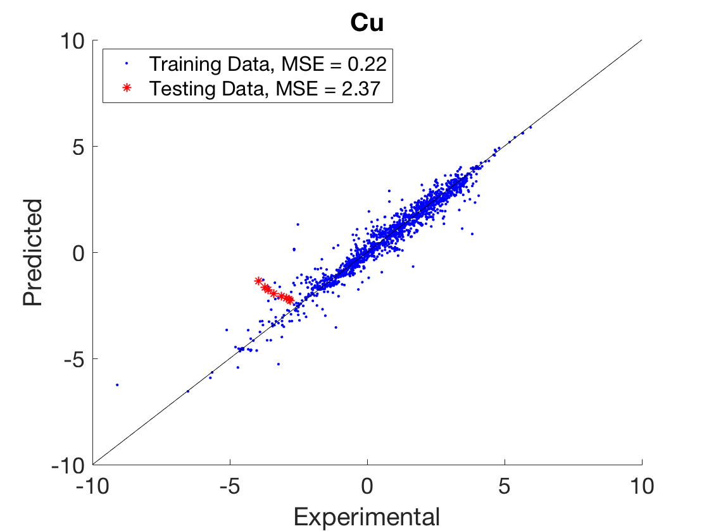

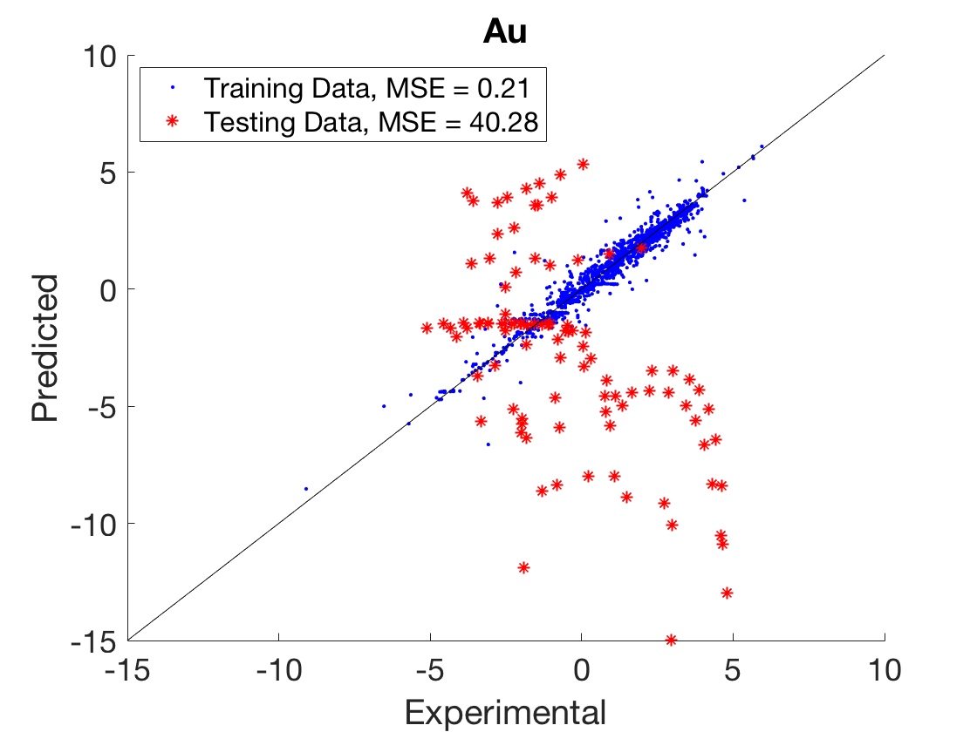
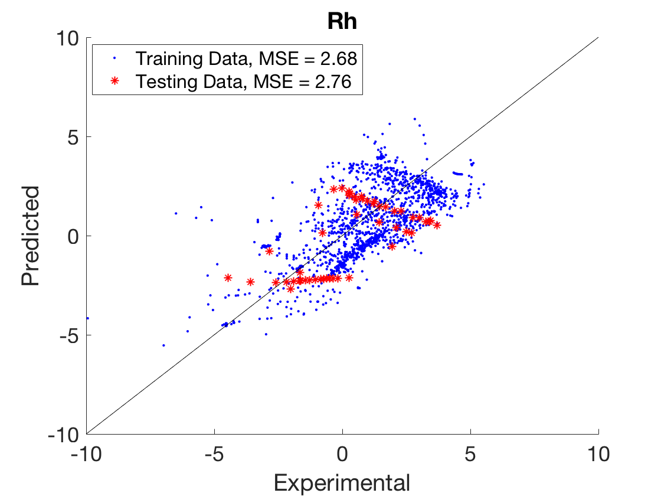
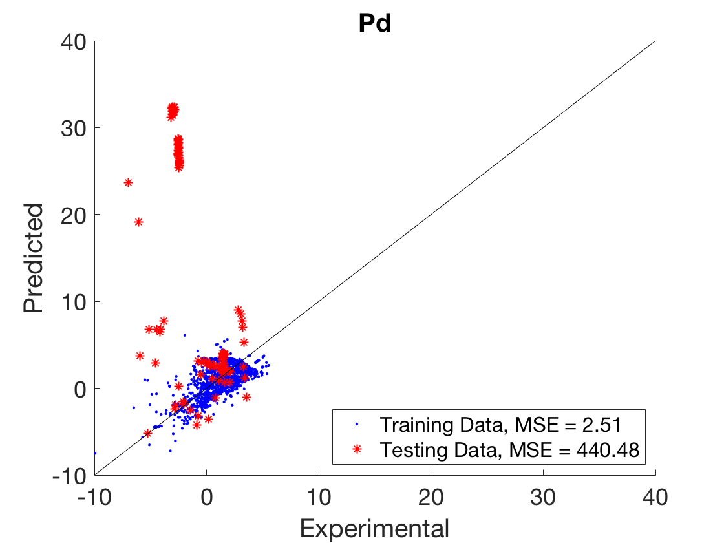
Interpolation Results - Primary Metals

Slide 27
Interpolation Results – Primary Metals
Number of Au Data Points = 99
Original Domain: -6.46 eV ≤ BE_{C} ≤ -3.06 eV
Au BE_{C} = -3.06 eV
Modified Domain: -6.46 eV ≤ BE_{C} ≤ -3.75 eV

Slide 28
Interpolation Results – Primary Metals
Number of Au Data Points = 99
Original Domain: -6.46 eV ≤ BE_{C} ≤ -3.06 eV
Au BE_{C} = -3.06 eV
Modified Domain: -6.46 eV ≤ BE_{C} ≤ -3.75 eV
Number of Pd Data Points = 105
Pd BE_{C} = -5.62 eV
Possible Explanations:
Unknowingly altered a different attribute’s domain
Preparation may lead to mechanistic differences, similar to behavior seen with Pt/CeO₂

Slide 29
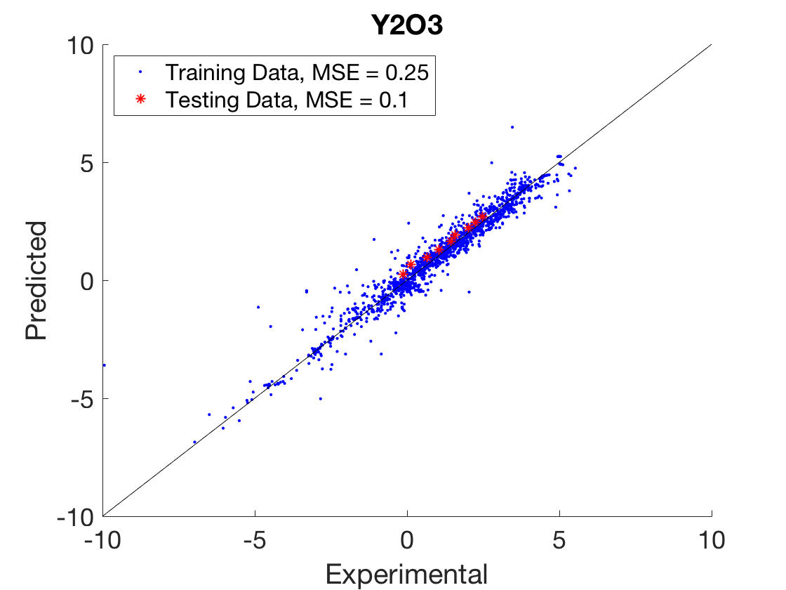
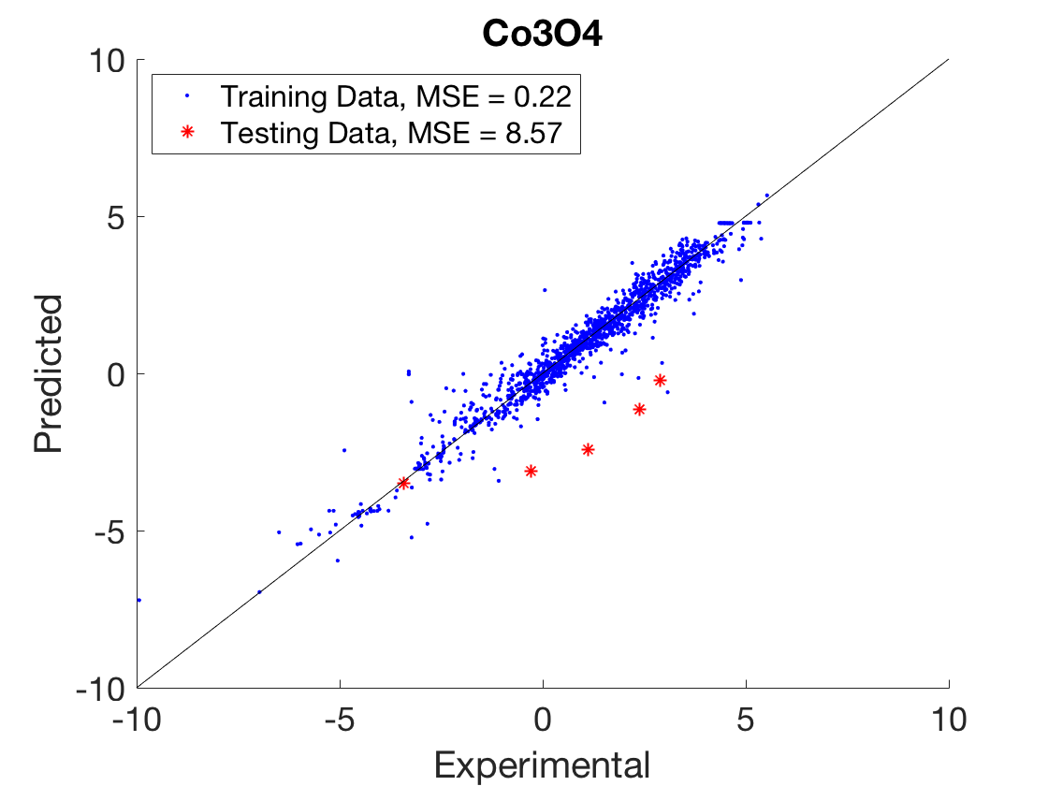
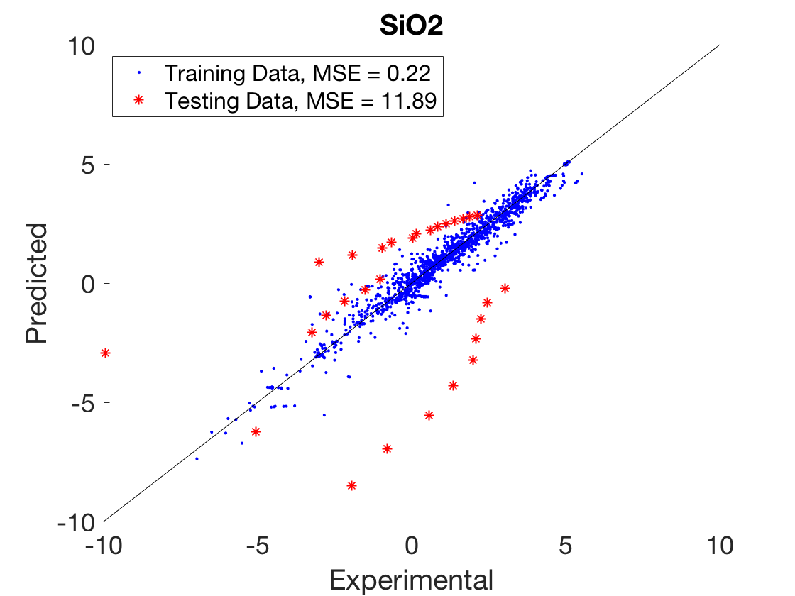
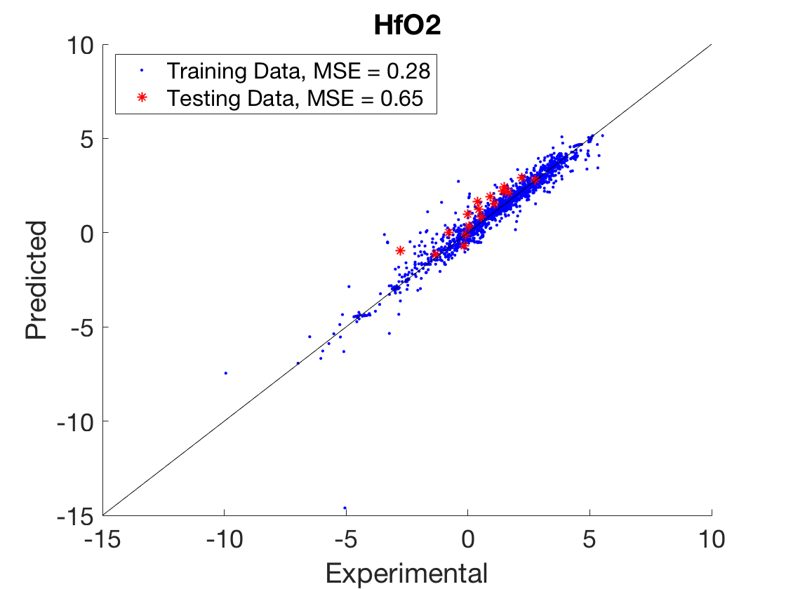
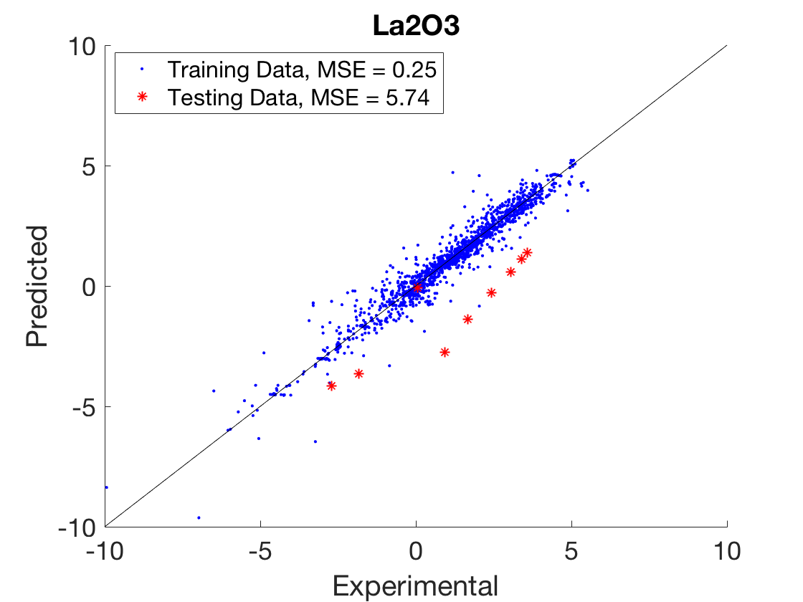
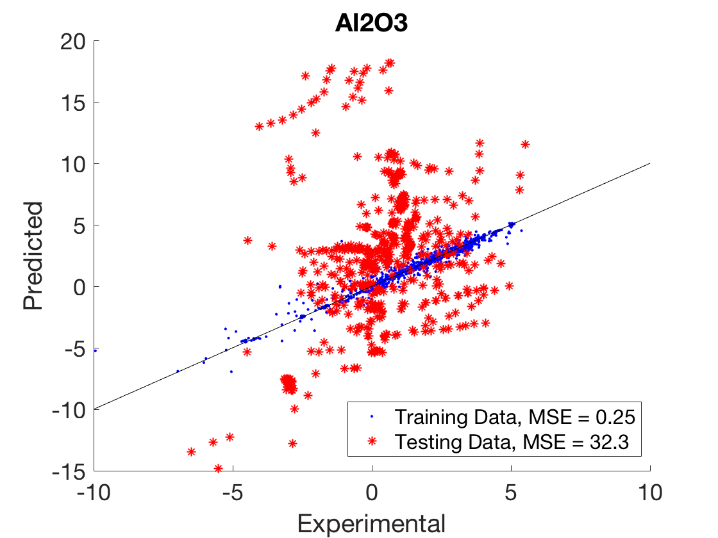
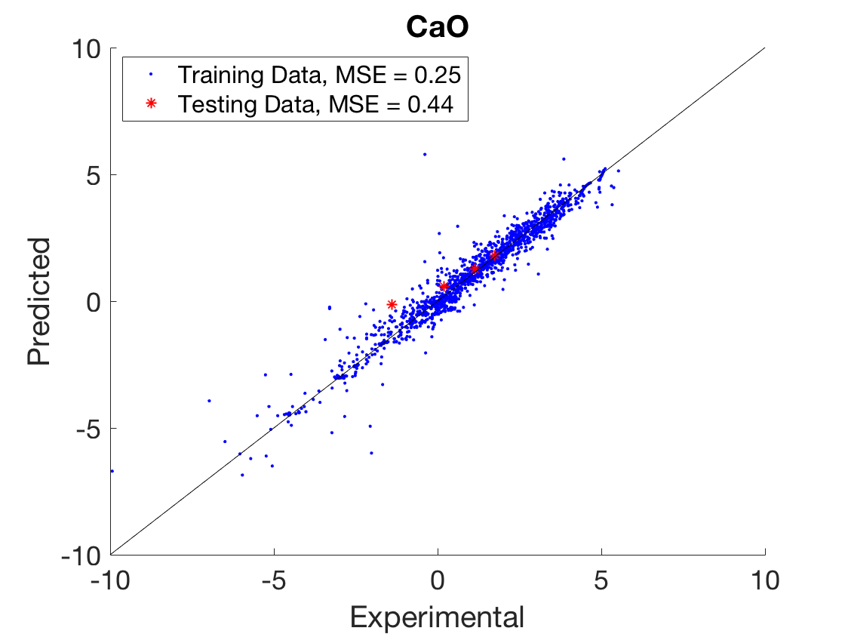
Interpolation Results – Supports

Slide 30
Interpolation Results – Supports
Number of SiO₂ Data Points = 29
Original Domain: 0.79 ≤ Electronegativity ≤ 1.91
SiO₂ Electronegativity = 1.91
Modified Domain: 0.79 ≤ Electronegativity ≤ 1.88

Slide 31
Interpolation Results – Supports
Number of SiO₂ Data Points = 29
Original Domain: 0.79 ≤ Electronegativity ≤ 1.91
SiO₂ Electronegativity = 1.91
Modified Domain: 0.79 ≤ Electronegativity ≤ 1.88
Number of Al₂O₃ Data Points = 556
Training Data Points = 943
First Ionization Energy = 578 kJ/mol
(Domain: 534 – 786)
Electronegativity = 1.61
(Domain: 0.79 – 1.91)
Notes:
Suggestion: consider different/additional attributes for the supports that may better capture support differences.

Slide 32
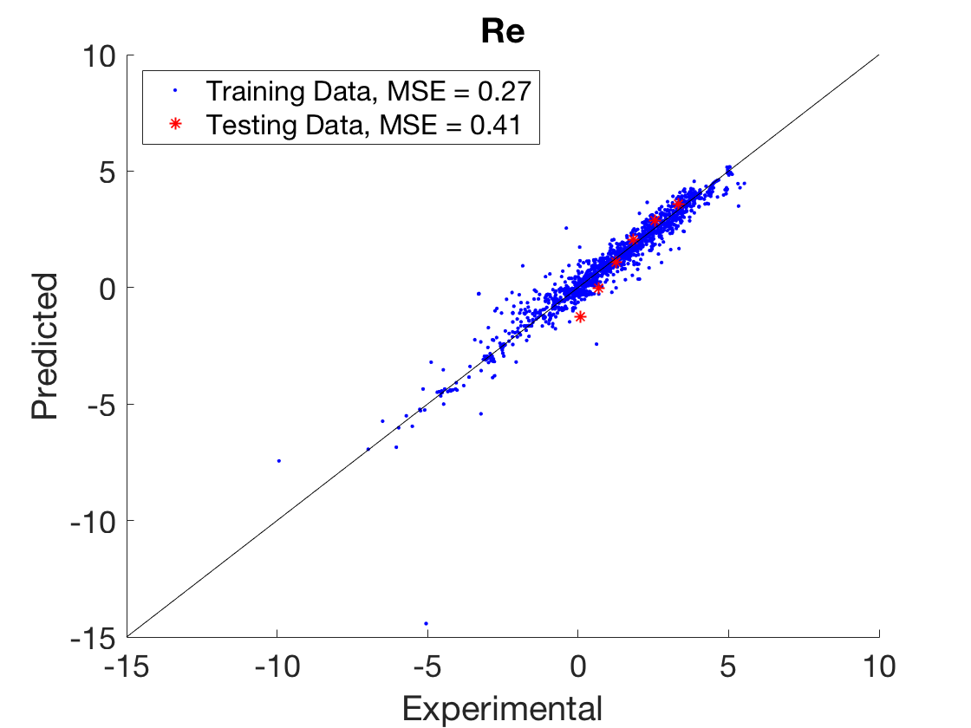
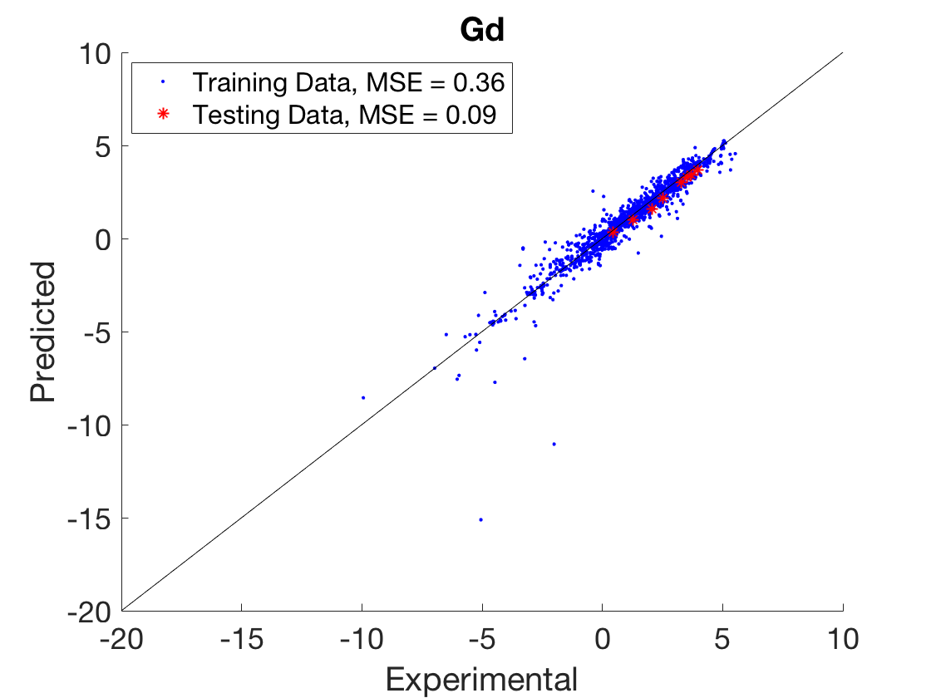
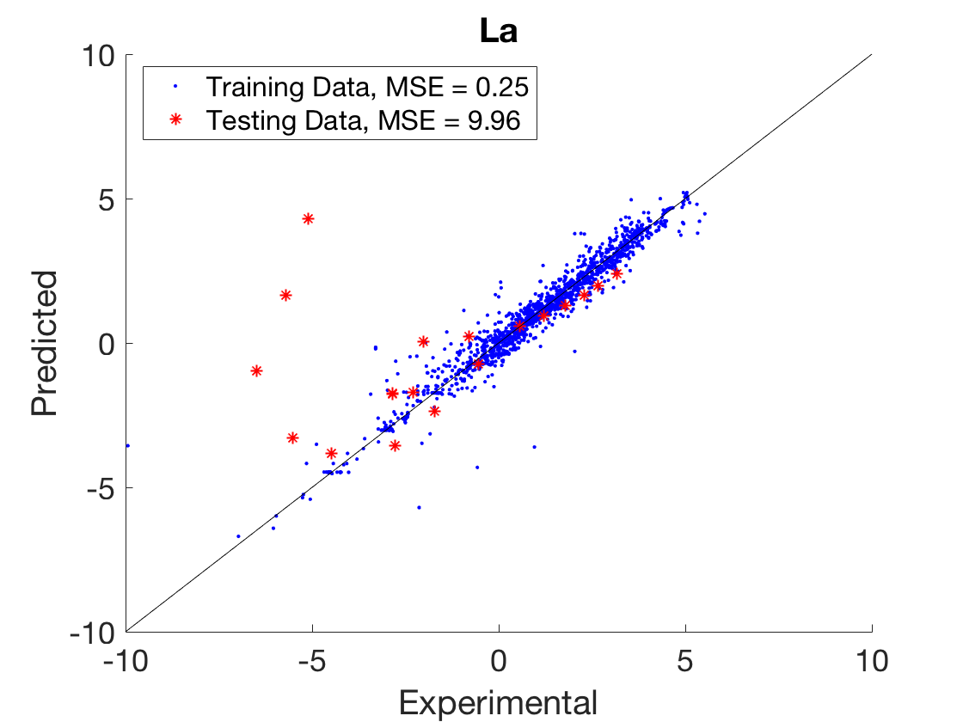
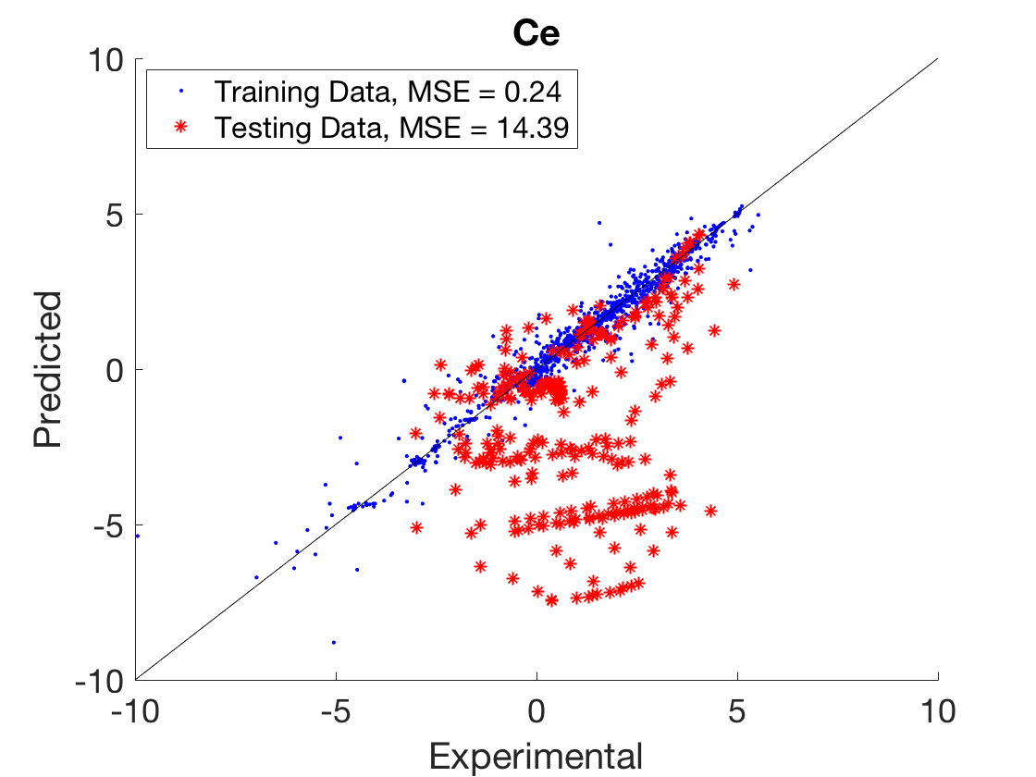
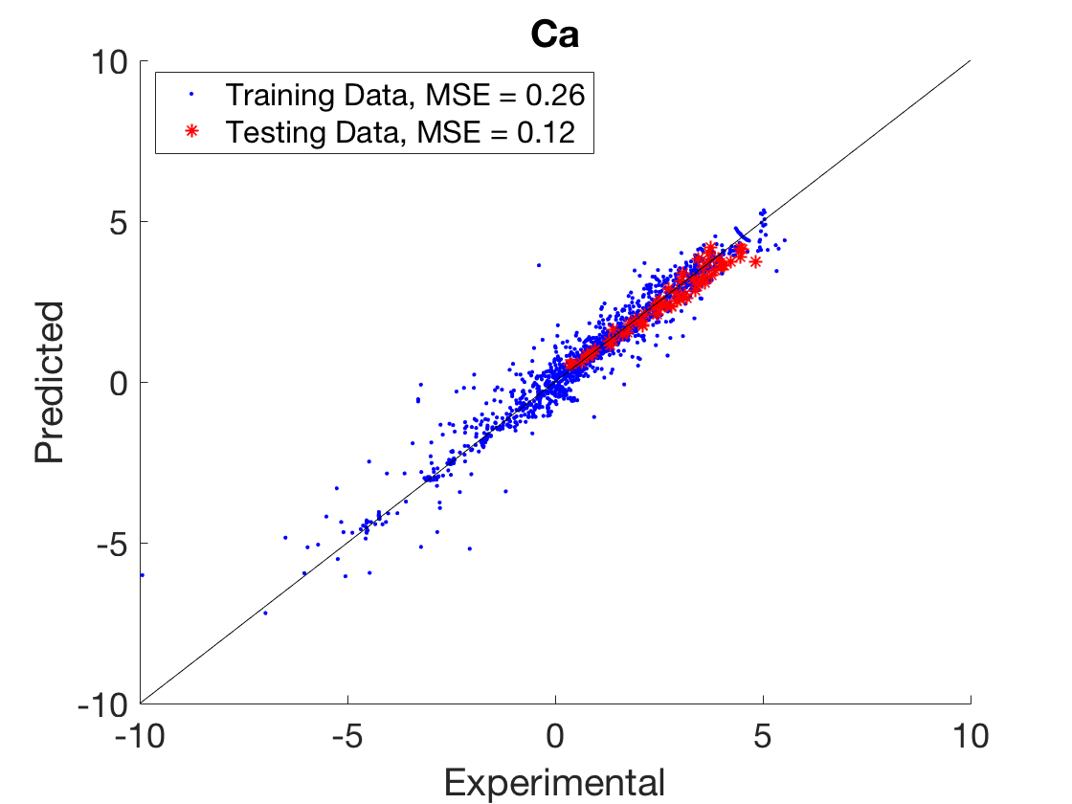
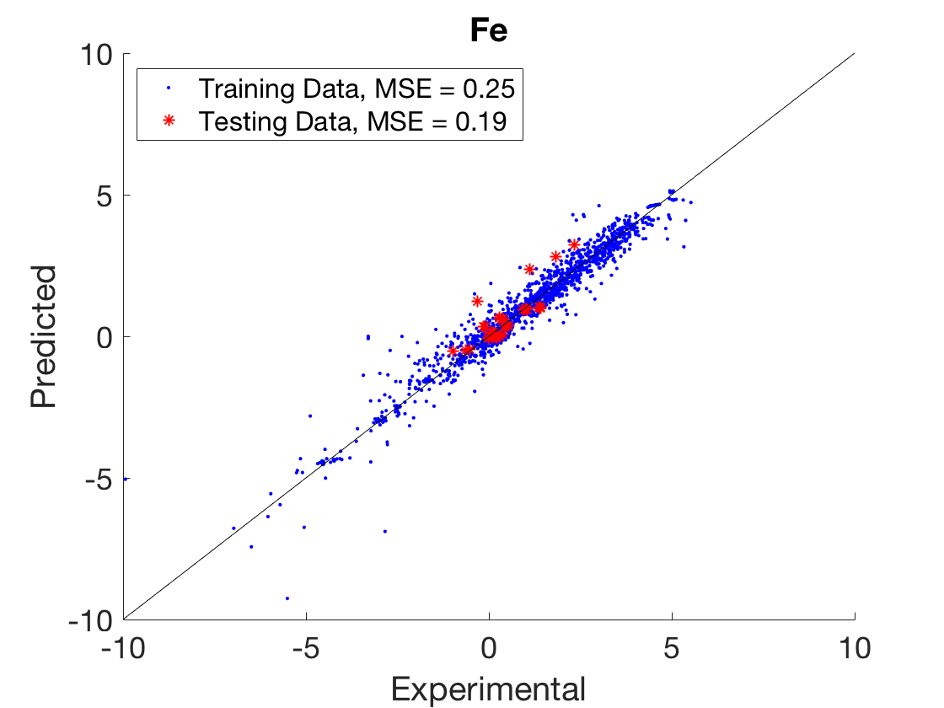
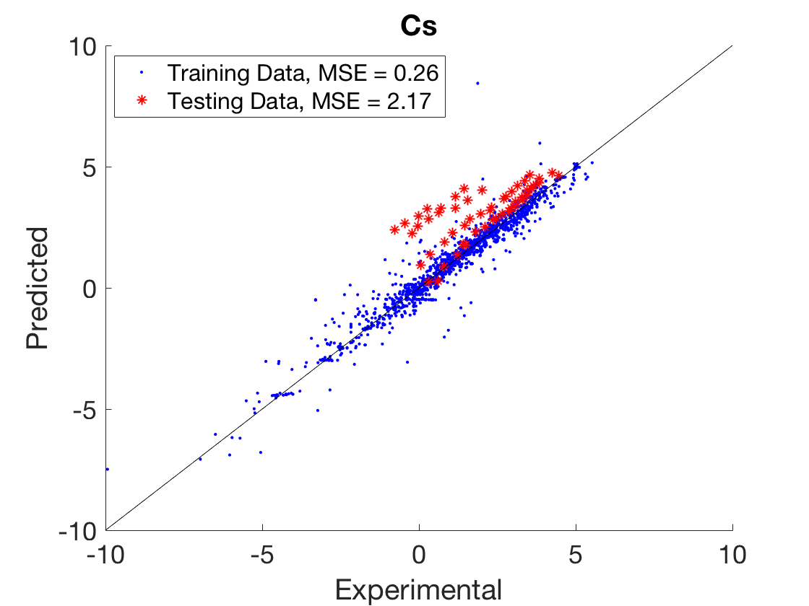
Interpolation Results – Promoters

Slide 33
Interpolation Results – Promoters
Original Domain
Electronegativity: 0.79 – 1.91
Charge/Ionic Radius: 0.06 – 1.52
Number of Cs Data Points = 54
Cs Electronegativity = 0.79
Cs Charge/Ionic Radius = 0.06
Notes:
Cs: Evaluate influence of changing domain on identifying other attributes where the domain would not be effected by the removal of Cs, and then re-doing this test

Slide 34
Interpolation Results – Promoters
Original Domain
Electronegativity: 0.79 – 1.91
Charge/Ionic Radius: 0.06 – 1.52
Number of Cs Data Points = 54
Cs Electronegativity = 0.79
Cs Charge/Ionic Radius = 0.06
Number of Ce Data Points = 297
Ce Electronegativity = 1.12
Ce Charge/Ionic Radius = 0.46
Notes:
Ce:
Both attributes are within the domain space, we do see some grouping in the parity plot. Possible that removing 30% of the data unknowingly effected the domain space of additional attributes, leading to incorrect predictions for the catalysts with thise features. Would require further examination of the effects of removing this data.

Slide 35
Interpolation Results – Promoters
Original Domain
Electronegativity: 0.79 – 1.91
Charge/Ionic Radius: 0.06 – 1.52
Number of Cs Data Points = 54
Cs Electronegativity = 0.79
Cs Charge/Ionic Radius = 0.06
Number of La Data Points = 19
La Electronegativity = 1.10
La Charge/Ionic Radius = 0.29
Number of Ce Data Points = 297
Ce Electronegativity = 1.12
Ce Charge/Ionic Radius = 0.46
Notes:
Most data point follow the scaling relationship, with only a few deviating. Could look into the source of the deviating data, likely that it originates from the same publication/lab. Possible that the techniques/equipment caused prediction problems.

Slide 36
Conclusions
Using diverse experimental data with ANNs can assist in identifying meaningful attributes and developing scaling relations.
Diverse
Experimental Data
Attribute
Determination

Slide 37
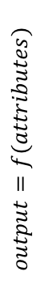
Conclusions
Using diverse experimental data with ANNs can assist in identifying meaningful attributes and developing scaling relations.
Diverse
Experimental Data
The scaling relations can then be applied to find optimum catalysts and identify catalysts which break scaling relations.
Attribute
Determination
Broken
Scaling
Relations
Optimum
Catalysts
$$output=f(attributes)$$

Slide 38
Next Steps – Sensitivity Analysis
Attribute | MSE | R²
No Attributes Removed, Base Case | 0.420 | 0.90
Binding Energy Carbon | 0.577 | 0.87
Primary Metal Loading, wt% | 0.454 | 0.89
Promoter Charge/Ionic Radius | 0.385 | 0.91
Promoter Electronegativity | 0.366 | 0.92
Promoter Loading, wt% | 0.348 | 0.91
Support, First Ionization Energy | 0.403 | 0.91
Support, Electronegativity | 0.414 | 0.90
Synthesis | 0.419 | 0.90
Calcination Temperature, C | 0.316 | 0.92
Calcination Time | 0.415 | 0.90
Reaction Temperature | 1.244 | 0.70
Reactant Feed, H2 vol% | 0.449 | 0.90
Reactant Feed, CO vol% | 0.430 | 0.90
Reactant Feed, H2O vol% | 0.446 | 0.90
Reactant Feed, CO2 vol% | 0.371 | 0.91
Time on Stream (min) | 0.357 | 0.92
Total Inlet Flowrate/Catalyst Mass | 0.463 | 0.90
Base Case should have the least error, comparable to the original model (MSE = 0.22 , R² = 0.95)

Slide 39
Next Steps – Sensitivity Analysis
Attribute | MSE | R²
No Attributes Removed, Base Case | 0.420 | 0.90
Binding Energy Carbon | 0.577 | 0.87
Primary Metal Loading, wt% | 0.454 | 0.89
Promoter Charge/Ionic Radius | 0.385 | 0.91
Promoter Electronegativity | 0.366 | 0.92
Promoter Loading, wt% | 0.348 | 0.91
Support, First Ionization Energy | 0.403 | 0.91
Support, Electronegativity | 0.414 | 0.90
Synthesis | 0.419 | 0.90
Calcination Temperature, C | 0.316 | 0.92
Calcination Time | 0.415 | 0.90
Reaction Temperature | 1.244 | 0.70
Reactant Feed, H2 vol% | 0.449 | 0.90
Reactant Feed, CO vol% | 0.430 | 0.90
Reactant Feed, H2O vol% | 0.446 | 0.90
Reactant Feed, CO2 vol% | 0.371 | 0.91
Time on Stream (min) | 0.357 | 0.92
Total Inlet Flowrate/Catalyst Mass | 0.463 | 0.90
Base Case should have the least error, comparable to the original model (MSE = 0.22 , R² = 0.95)
Introduce a temperature correction or justify the lack thereof
Currently temperature-dependence dominates the model
Prevents a meaningful analysis of the sensitivity to other features

Slide 40
Future Directions
Develop model/relationship that allows for the inclusion of mixed metal-oxide supports
→ 30% increase in dataset size
Removal Criteria | Order Independent | Sequential Removal | Remaining Data Points
Original Data | --- | --- | 4360
Mixed Supports | 953 | 642 | 2228
Identification of “best” catalyst
I used the best catalyst in the post-cleaning dataset
Better to test inputs throughout the domain space

Slide 41
Future Directions
Develop model/relationship that allows for the inclusion of mixed metal-oxide supports
→ 30% increase in dataset size
Removal Criteria | Order Independent | Sequential Removal | Remaining Data Points
Original Data | --- | --- | 4360
Mixed Supports | 953 | 642 | 2228
Identification of “best” catalyst
I used the best catalyst in the post-cleaning dataset
Better to test inputs throughout the domain space
Attribute | Minimum | Maximum
Binding Energy Carbon | -1.2 | 3.6
Primary Metal Loading | -0.39 | 8.9
Promoter Charge/Ionic Radius | -0.85 | 3.4
Promoter Electronegativity | -1.2 | 1.6
Promoter Loading | -0.61 | 3.2
More appropriate Normalization of Attributes
Attribute Selection & Optimization Procedure
→ Consider clustering techniques

Slide 42
Acknowledgements
UW 2020 Funding
Prof. Dumesic and Prof. Huber for their guidance on the catalysis portion of this project
Prof. Zavala & Post Doc. Yankai for their assistance with the machine-learning portion
Prof. Maravelias for participating on my examination committee
Questions?

Slide 43
Extra Slides

Slide 44
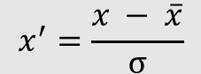
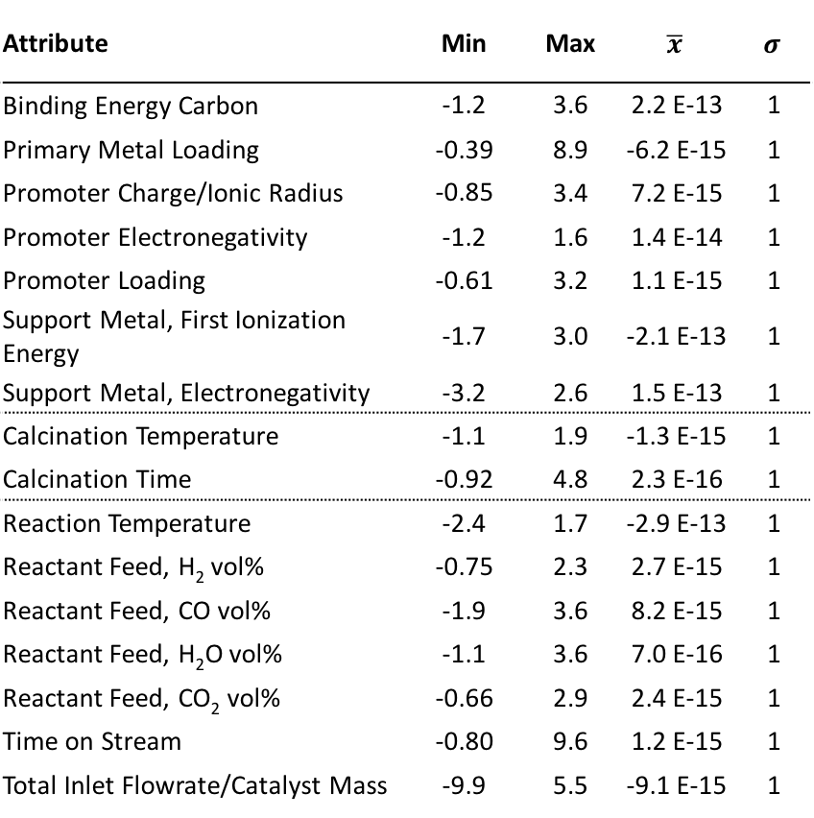
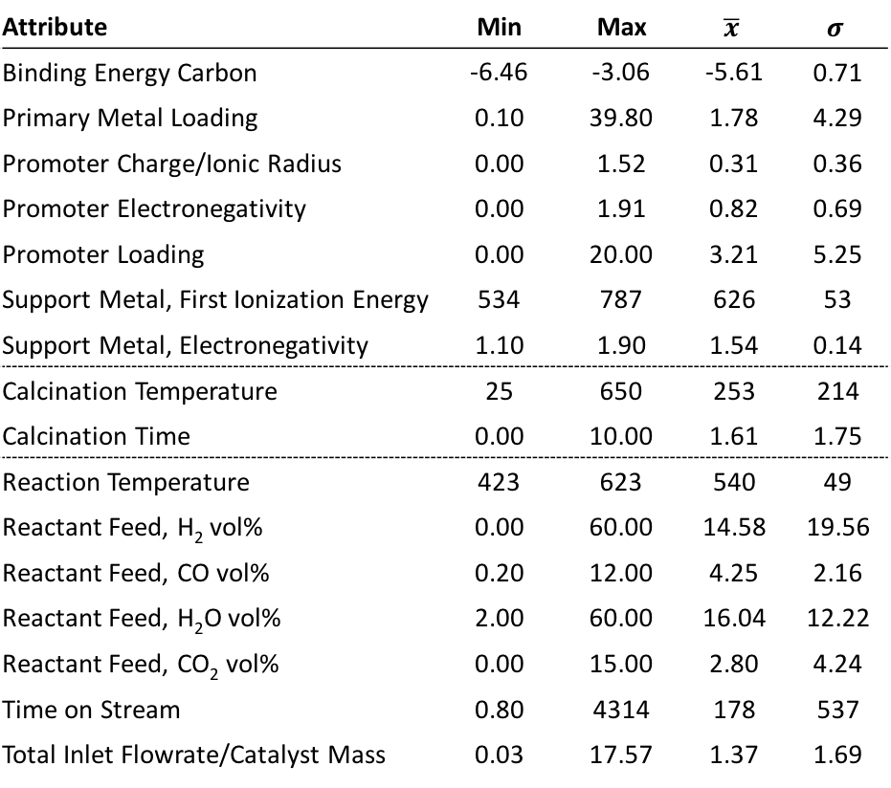
Data Normalization
$$x^{′}=\frac{x − \overline{x}}{σ}$$
Attribute | Min | Max | $$\overline{x}$$ | $$σ$$
Binding Energy Carbon | -1.2 | 3.6 | 2.2 E-13 | 1
Primary Metal Loading | -0.39 | 8.9 | -6.2 E-15 | 1
Promoter Charge/Ionic Radius | -0.85 | 3.4 | 7.2 E-15 | 1
Promoter Electronegativity | -1.2 | 1.6 | 1.4 E-14 | 1
Promoter Loading | -0.61 | 3.2 | 1.1 E-15 | 1
Support Metal, First Ionization Energy | -1.7 | 3.0 | -2.1 E-13 | 1
Support Metal, Electronegativity | -3.2 | 2.6 | 1.5 E-13 | 1
Calcination Temperature | -1.1 | 1.9 | -1.3 E-15 | 1
Calcination Time | -0.92 | 4.8 | 2.3 E-16 | 1
Reaction Temperature | -2.4 | 1.7 | -2.9 E-13 | 1
Reactant Feed, H₂ vol% | -0.75 | 2.3 | 2.7 E-15 | 1
Reactant Feed, CO vol% | -1.9 | 3.6 | 8.2 E-15 | 1
Reactant Feed, H₂O vol% | -1.1 | 3.6 | 7.0 E-16 | 1
Reactant Feed, CO₂ vol% | -0.66 | 2.9 | 2.4 E-15 | 1
Time on Stream | -0.80 | 9.6 | 1.2 E-15 | 1
Total Inlet Flowrate/Catalyst Mass | -9.9 | 5.5 | -9.1 E-15 | 1
Attribute | Min | Max | $$\overline{x}$$ | $$σ$$
Binding Energy Carbon | -6.46 | -3.06 | -5.61 | 0.71
Primary Metal Loading | 0.10 | 39.80 | 1.78 | 4.29
Promoter Charge/Ionic Radius | 0.00 | 1.52 | 0.31 | 0.36
Promoter Electronegativity | 0.00 | 1.91 | 0.82 | 0.69
Promoter Loading | 0.00 | 20.00 | 3.21 | 5.25
Support Metal, First Ionization Energy | 534 | 787 | 626 | 53
Support Metal, Electronegativity | 1.10 | 1.90 | 1.54 | 0.14
Calcination Temperature | 25 | 650 | 253 | 214
Calcination Time | 0.00 | 10.00 | 1.61 | 1.75
Reaction Temperature | 423 | 623 | 540 | 49
Reactant Feed, H₂ vol% | 0.00 | 60.00 | 14.58 | 19.56
Reactant Feed, CO vol% | 0.20 | 12.00 | 4.25 | 2.16
Reactant Feed, H₂O vol% | 2.00 | 60.00 | 16.04 | 12.22
Reactant Feed, CO₂ vol% | 0.00 | 15.00 | 2.80 | 4.24
Time on Stream | 0.80 | 4314 | 178 | 537
Total Inlet Flowrate/Catalyst Mass | 0.03 | 17.57 | 1.37 | 1.69

Slide 45
Training Parameters & Specifications
Parameter | Specification
Error Function | Mean-squared error
Backpropagation | Bayesian Regularization
Maximum Iterations | 2,500
Training Data | 56% of total data
Cross Validation Data | 24% of total data
Testing Data | 20% of total data
Training Optimization Algorithm
Randomize the data 5 times
For each randomization, train (n) ANNs
For each ANN, evaluate the ANN performance
Record best performance of the (n) ANNs
Average the performance over (m) randomizations
Matlab, Neural Network Toolbox
fitnet() function with the specified parameters

Slide 46
Optimizing ANN Architecture
1st Hidden Layer | 2nd Hidden Layer | Weights in Network | Average MSE | Best MSE
5 | 0 | 120 | 0.47 | 0.35
5 | 1 | 121 | 0.39 | 0.27
5 | 2 | 127 | 0.52 | 0.36
5 | 3 | 133 | 0.44 | 0.25
5 | 4 | 139 | 0.49 | 0.27
6 | 0 | 144 | 0.43 | 0.33
6 | 1 | 145 | 0.47 | 0.38
6 | 2 | 152 | 0.35 | 0.23
6 | 3 | 159 | 0.43 | 0.25
6 | 4 | 166 | 0.39 | 0.28
7 | 0 | 168 | 0.43 | 0.25
7 | 1 | 169 | 0.60 | 0.34
7 | 2 | 177 | 0.41 | 0.26
7 | 3 | 185 | 0.58 | 0.34
7 | 4 | 193 | 0.37 | 0.30
8 | 0 | 192 | 0.36 | 0.23
8 | 1 | 193 | 0.43 | 0.27
8 | 2 | 202 | 0.47 | 0.37
8 | 3 | 211 | 0.53 | 0.28
8 | 4 | 220 | 0.56 | 0.37
Layer 1 | Layer 2 | Weights | Average MSE | Best MSE
5 | 1 | 121 | 0.41 | 0.31
6 | 2 | 152 | 0.40 | 0.19
8 | 0 | 192 | 0.38 | 0.29

Slide 47
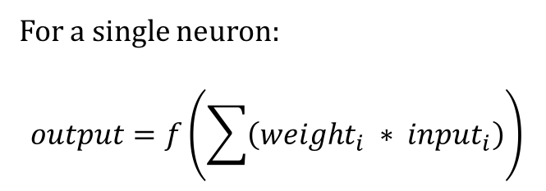
ANN Math
Artificial Neural Networks
Are made up of interconnected neurons (weights and nodes)
Store information as a mathematical model
“Learn” through iterative perturbations and complex backpropagation algorithms
For a single neuron:
$$output=f\left(\sum{\left({weight}_{i} ∗ {input}_{i}\right)}\right)$$

Slide 48
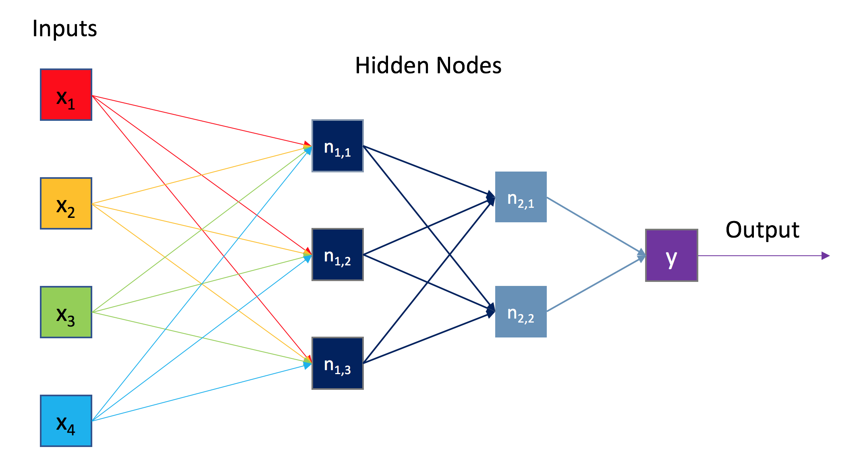
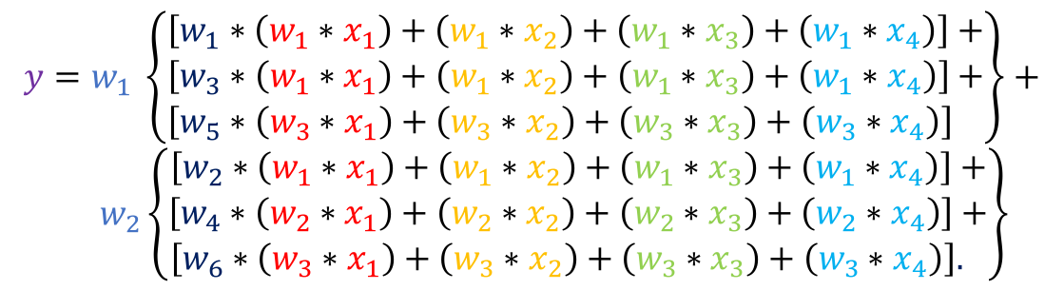
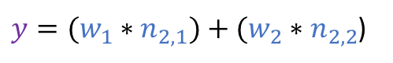
ANN Math
$y=(w_{1}∗n_{2,1})+(w_{2}∗n_{2,2}$)
$$y=w_{1}\left(\left(w_{1}∗n_{1,1}\right)+\left(w_{3}∗n_{1,2}\right)+\left(w_{5}∗n_{1,3}\right)\right)+$$
$w_{2}\left(\left(w_{2}∗n_{1,1}\right)+\left(w_{4}∗n_{1,2}\right)+\left(w_{6}∗n_{1,3}\right)\right)$
Overall Equation is Nested Weighted Summations
$$y=w_{1} \left\{\begin{aligned}\left[w_{1}∗\left(w_{1}∗x_{1}\right)+\left(w_{1}∗x_{2}\right)+\left(w_{1}∗x_{3}\right)+\left(w_{1}∗x_{4}\right)\right]+ \\ \begin{aligned}\left[w_{3}∗\left(w_{1}∗x_{1}\right)+\left(w_{1}∗x_{2}\right)+\left(w_{1}∗x_{3}\right)+\left(w_{1}∗x_{4}\right)\right]+ \\ \left[w_{5}∗\left(w_{3}∗x_{1}\right)+\left(w_{3}∗x_{2}\right)+\left(w_{3}∗x_{3}\right)+\left(w_{3}∗x_{4}\right)\right] \end{aligned}\end{aligned}\right\}+$$
$w_{2}\left\{\begin{aligned}\left[w_{2}∗\left(w_{1}∗x_{1}\right)+\left(w_{1}∗x_{2}\right)+\left(w_{1}∗x_{3}\right)+\left(w_{1}∗x_{4}\right)\right]+ \\ \begin{aligned}\left[w_{4}∗\left(w_{2}∗x_{1}\right)+\left(w_{2}∗x_{2}\right)+\left(w_{2}∗x_{3}\right)+\left(w_{2}∗x_{4}\right)\right]+ \\ \left[w_{6}∗\left(w_{3}∗x_{1}\right)+\left(w_{3}∗x_{2}\right)+\left(w_{3}∗x_{3}\right)+\left(w_{3}∗x_{4}\right)\right]. \end{aligned}\end{aligned}\right\}$

Slide 49
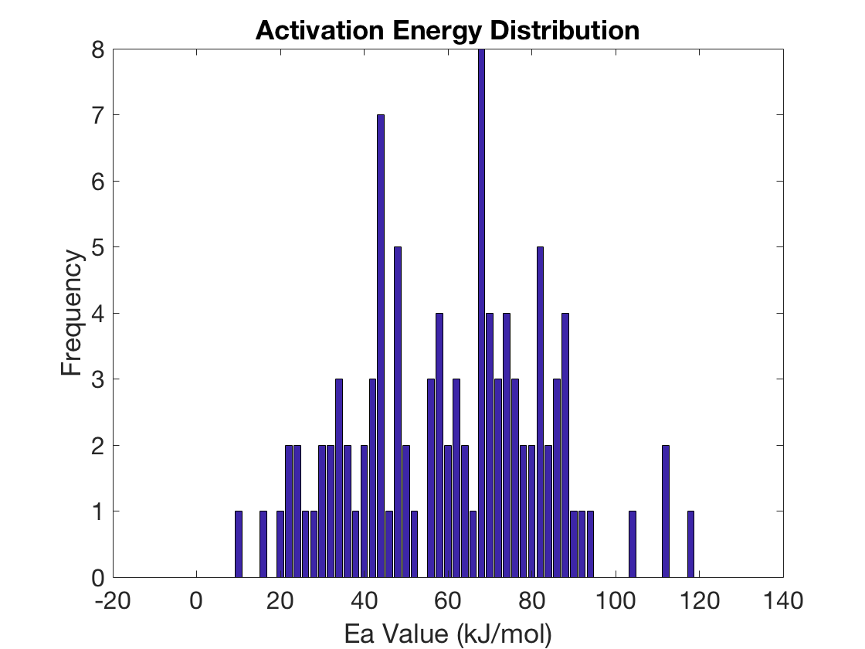
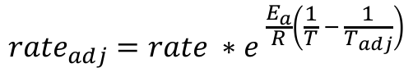
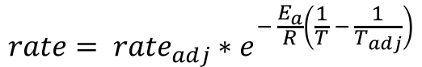
Temperature Correction
$$rate= {rate}_{adj}∗e^{− \frac{E_{a}}{R}\left(\frac{1}{T} − \frac{1}{T_{adj}}\right)}$$
$${rate}_{adj}=rate ∗e^{ \frac{E_{a}}{R}\left(\frac{1}{T} − \frac{1}{T_{adj}}\right)}$$
Chose Ea = 70 kJ/mol

